Slide 1


Anglicky v odborných předmětech
"Support of teaching technical subjects in English“
Tutorial: Mechanic – electrician
Topic: Electronics
II. class
RC Filters:
RC Low Pass Filter
Created by: Ing. Jaroslav Bernkopf
AVOP-ELEKTRO-Ber-007
Projekt Anglicky v odborných předmětech, CZ.1.07/1.3.09/04.0002
je spolufinancován Evropským sociálním fondem a státním rozpočtem České republiky.

Slide 2
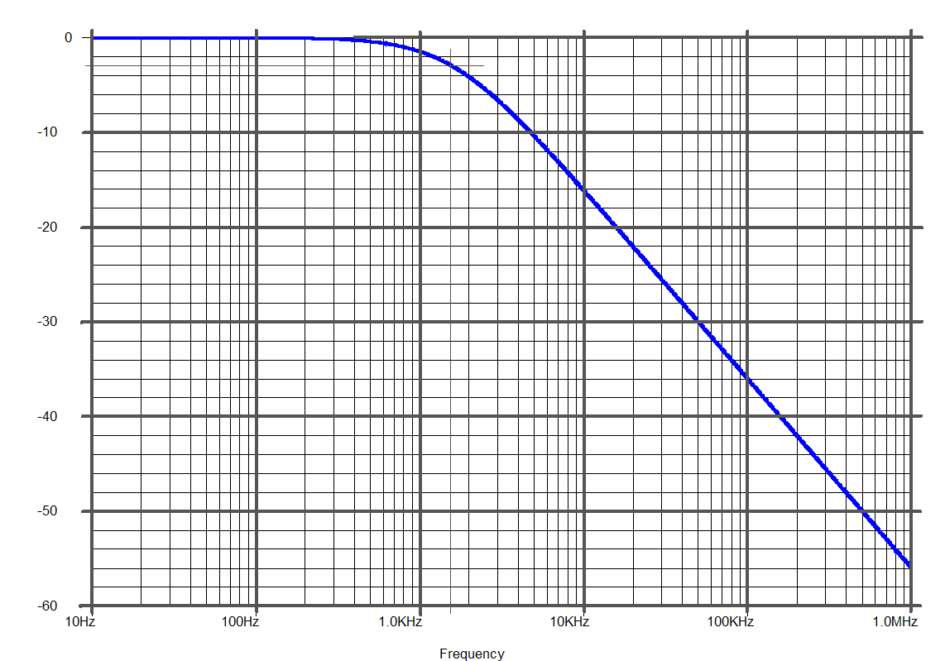
Definition
A low-pass filter is a circuit that passes low-frequency signals but attenuates signals with frequencies higher than the cutoff frequency.
-3 dB
Slope:
-20 dB/decade
(-6 dB/octave)
Cutoff frequency
Passband
Stopband
f

Slide 3
Description
The simplest low-pass filter consists of one resistor and one capacitor.
We call it the RC low-pass filter.
-3 dB
A
Slope:
-20 dB/decade
(-6 dB/octave)
Cutoff frequency
Passband
Stopband
f

Slide 4
Description
Let‘s construct the gain-frequency characteristic of the RC low-pass filter.
Let‘s apply a voltage V_{in} of a very low frequency and of an amplitude of 10V to the input of the circuit in the figure.
If we let the frequency become lower and lower, the input voltage will become a DC voltage.
This input voltage V_{in} of 10V will charge the capacitor and in a moment the output voltage V_{out} will reach 10V and will be the same as the input voltage V_{in}.
A_{v}
1
0
f

Slide 5
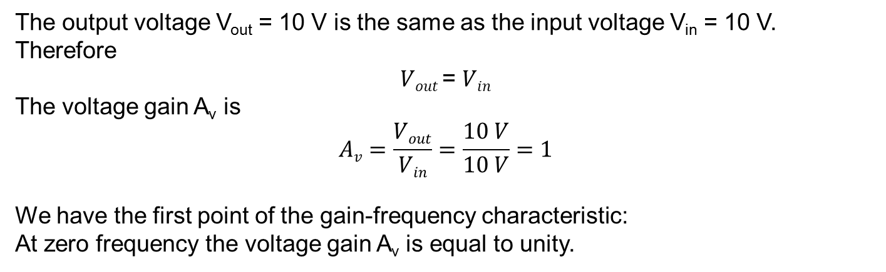
Description
The output voltage V_{out} = 10 V is the same as the input voltage V_{in} = 10 V.
Therefore
$Vout$= $Vin$
The voltage gain A_{v} is
$$Av=\frac{Vout}{Vin}=\frac{10 V}{10 V}=1$$
We have the first point of the gain-frequency characteristic:
At zero frequency the voltage gain A_{v} is equal to unity.
A_{v}
1
A = 1
f = 0
0
f

Slide 6
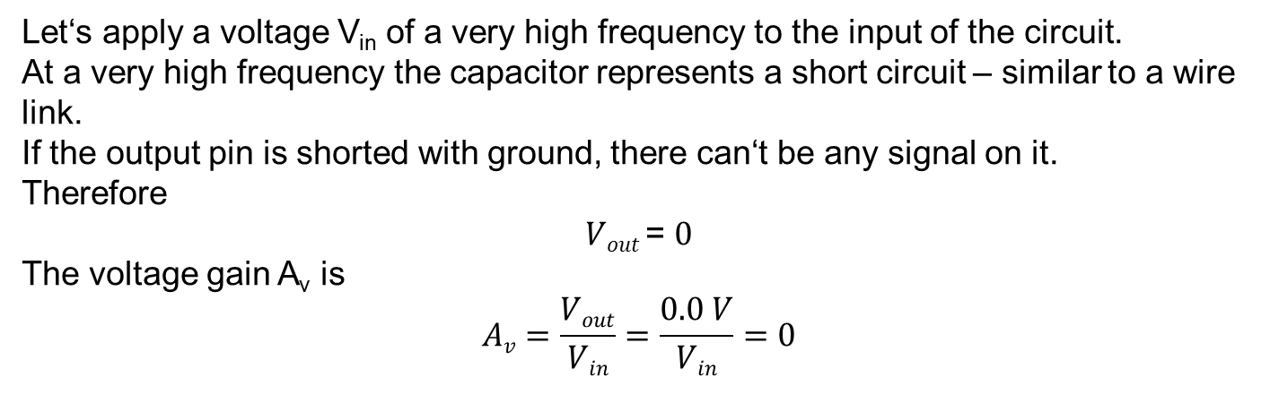
Description
Let‘s apply a voltage V_{in} of a very high frequency to the input of the circuit.
At a very high frequency the capacitor represents a short circuit – similar to a wire link.
If the output pin is shorted with ground, there can‘t be any signal on it.
Therefore
$Vout$= $0$
The voltage gain A_{v} is
$$Av=\frac{Vout}{Vin}=\frac{0.0 V}{Vin}=0$$
A_{v}
1
A = 0
f = ∞
0
f

Slide 7
Description
We have the second point of the gain-frequency characteristic:
At infinite frequency the voltage gain A_{v} is equal to zero.
A_{v}
1
A_{v} = 0
f = ∞
0
f

Slide 8

Description
Between these two points there is a point where the unity gain ends and the gain is starting to fall.
We call this point the cutoff frequency.
Unity gain ends
A_{v} = 0,707
A_{v}
Gain is starting to fall
1
$$fc=\frac{1}{2πRC}$$
0
f_{c}
f

Slide 9
Description
In the passband all signal passes from the input to the output.
The voltage gain A_{v} is equal to unity.
-3 dB
A
Slope:
-20 dB/decade
(-6 dB/octave)
Cutoff frequency
Passband
Stopband
f

Slide 10
Description
In the stopband the higher the frequency, the lower the voltage gain A_{v}.
The gain A_{v} falls off at 20 dB per decade (or 6 dB per octave, which tells the same).
When the frequency increases by a factor of 10, the gain decreases by a factor of 10 (i.e. 20 dB).
When the frequency increases by a factor of 2, the gain decreases by a factor of 2 (i.e. 6 dB).
-3 dB
A
Slope:
-20 dB/decade
(-6 dB/octave)
Cutoff frequency
Passband
Stopband
f

Slide 11
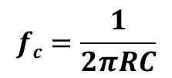
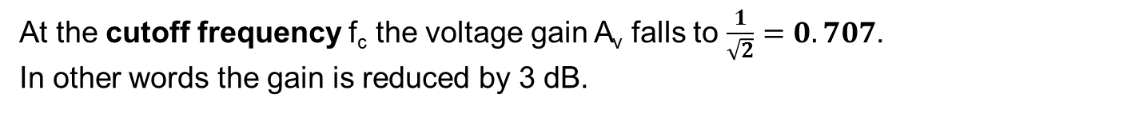
Description
At the cutoff frequency f_{c} the voltage gain A_{v} falls to $\frac{1}{\sqrt{2}}=0.707$.
In other words the gain is reduced by 3 dB.
Here is the formula for the cut-off frequency:
$$fc=\frac{1}{2πRC}$$
-3 dB
A
Slope:
-20 dB/decade
(-6 dB/octave)
Cutoff frequency
Passband
Stopband
f

Slide 12
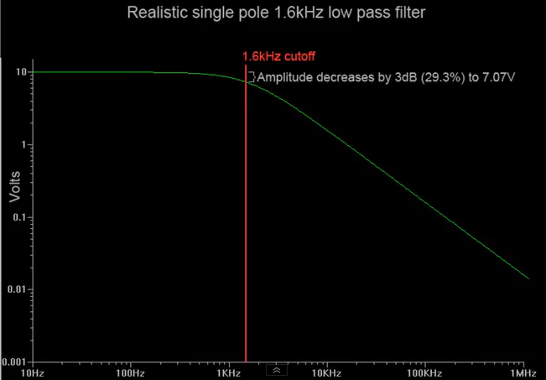
Low pass filter– video
  Passive RC low pass filter https://www.youtube.com/watch?v=OBM5T5_kgdI&feature=em-subs_digest-vrecs

Slide 13
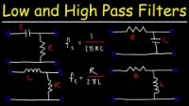
Low pass filter– video
  Passive RC low and high pass filter
  https://www.youtube.com/watch?v=lagfhNjMuQM

Slide 14
Task
Calculate the cut-off frequency for the circuit below and state if it is high pass or low pass.
10k
10n

Slide 15
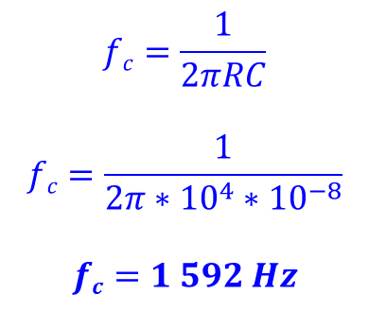
Solution
$$fc=\frac{1}{2πRC}$$
$$fc=\frac{1}{2π∗{10}^{4}∗{10}^{−8}}$$
$$fc=1 592 Hz$$
The cut-off frequency of the circuit is 1 592 Hz.
A signal of the lowest frequency – a DC signal – passes through the resistor without being reduced by the capacitor.
The circuit is a low-pass filter.
10k
10n

Slide 16
References
http://www.wikipedia.com
http://www.thefreedictionary.com
http://www.animations.physics.unsw.edu.au/jw/calculus.htm
http://openlearn.open.ac.uk/

