Slide 1


Anglicky v odborných předmětech
"Support of teaching technical subjects in English“
Tutorial: Mechanic – electrician
Topic: Electronics
II. class
RC Filters:
RC High Pass Filter
Prepared by: Ing. Jaroslav Bernkopf
AVOP-ELEKTRO-Ber-008
Projekt Anglicky v odborných předmětech, CZ.1.07/1.3.09/04.0002
je spolufinancován Evropským sociálním fondem a státním rozpočtem České republiky.

Slide 2
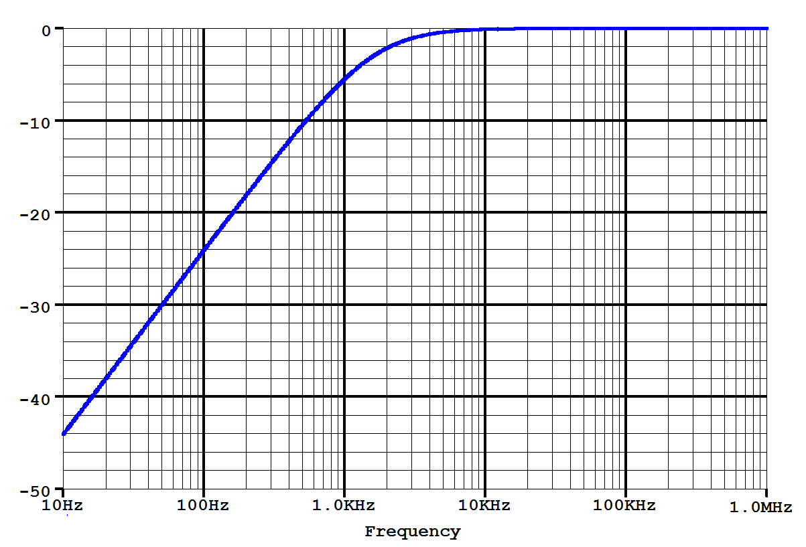
Definition
A high-pass filter is a circuit that passes high-frequency signals but attenuates signals with frequencies lower than the cutoff frequency.
-3 dB
Slope:
20 dB/decade
(6 dB/octave)
Cutoff frequency
Stopband
Passband
f

Slide 3
Description
The simplest high-pass filter consists of one resistor and one capacitor.
We call it the RC high-pass filter.
-3 dB
Slope:
20 dB/decade
(6 dB/octave)
A
Cutoff frequency
Stopband
Passband
f

Slide 4
Description
Let‘s construct the gain-frequency characteristic of the RC high-pass filter.
Let‘s apply a voltage V_{in} of a very low frequency to the input of the circuit.
If the frequency becomes lower and lower, the input voltage will become a DC voltage.
No DC current can pass through the capacitor because there is an insulator between its electrodes.
No DC signal can pass from the input of this circuit to its output.
A_{v}
1
0
f

Slide 5
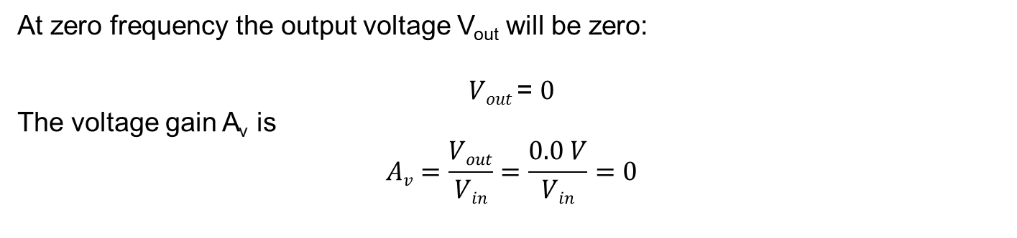
Description
At zero frequency the output voltage V_{out} will be zero:
$Vout$= $0$
The voltage gain A_{v} is
$$Av=\frac{Vout}{Vin}=\frac{0.0 V}{Vin}=0$$
A_{v}
1
f = 0
A_{v} = 0
0
f

Slide 6
Description
We have the first point of the gain-frequency characteristic:
At zero frequency the voltage gain A_{v} is equal to zero.
A_{v}
1
f = 0
A_{v} = 0
0
f

Slide 7
Description
Let‘s apply a voltage V_{in} of a very high frequency and of an amplitude of 10V to the input of the circuit.
At a very high frequency the capacitor represents a short circuit – similar to a wire link.
If the output pin is shorted with the input pin, there must be the same signal on it.
A_{v}
1
0
f

Slide 8
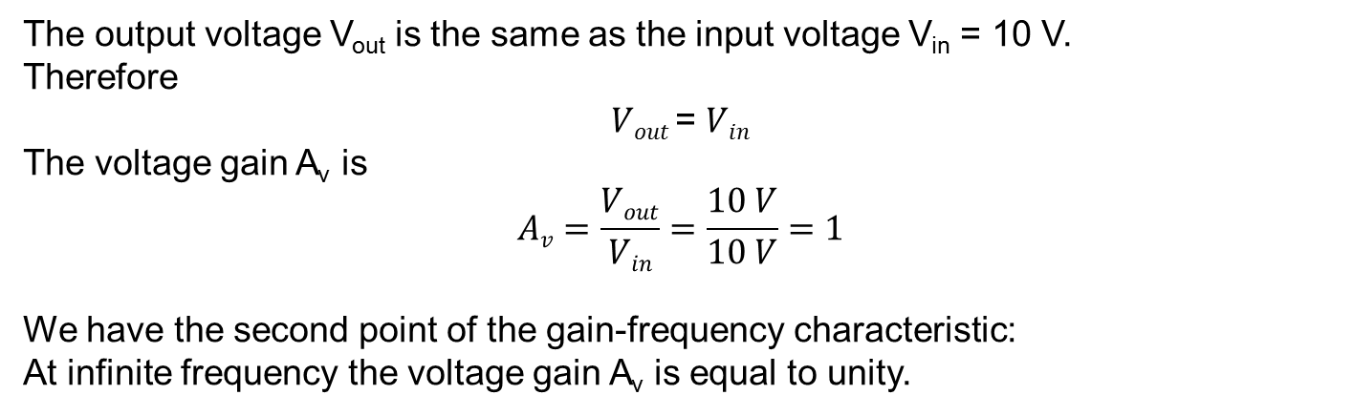
Description
The output voltage V_{out} is the same as the input voltage V_{in} = 10 V.
Therefore
$Vout$= $Vin$
The voltage gain A_{v} is
$$Av=\frac{Vout}{Vin}=\frac{10 V}{10 V}=1$$
We have the second point of the gain-frequency characteristic:
At infinite frequency the voltage gain A_{v} is equal to unity.
A_{v}
1
A_{v} = 1
f = ∞
0
f

Slide 9

Description
Between these two points there is a point where the gain stops rising and starts to be unity.
We call this point the cutoff frequency.
A_{v}
A_{v} = 0,707
Gain is unity
1
Gain is rising
$$fc=\frac{1}{2πRC}$$
0
f_{c}
f

Slide 10
Description
In the passband all signal passes from the input to the output.
The voltage gain A_{v} is equal to unity.
-3 dB
Slope:
20 dB/decade
(6 dB/octave)
A
Cutoff frequency
Stopband
Passband
f

Slide 11
Description
In the stopband the lower the frequency, the lower the voltage gain A_{v}.
The gain A_{v} falls off at 20 dB per decade (or 6 dB per octave, which tells the same).
When the frequency decreases by a factor of 10, the gain decreases by a factor of 10 (i.e. 20 dB).
When the frequency decreases by a factor of 2, the gain decreases by a factor of 2 (i.e. 6 dB).
-3 dB
Slope:
20 dB/decade
(6 dB/octave)
A
Cutoff frequency
Stopband
Passband
f

Slide 12
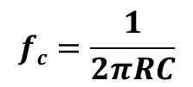

Description
At the cutoff frequency f_{c} the voltage gain A_{v} falls to $\frac{1}{\sqrt{2}}=0.707$.
In other words the gain is reduced by 3 dB.
Here is the formula for the cut-off frequency:
-3 dB
$$fc=\frac{1}{2πRC}$$
Slope:
20 dB/decade
(6 dB/octave)
A
Cutoff frequency
Stopband
Passband
f

Slide 13
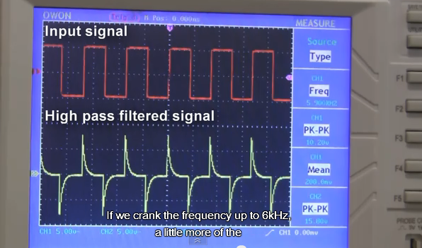
High pass filter– video
  Passive RC high pass filters
  https://www.youtube.com/watch?v=4CcIFycCnxU

Slide 14
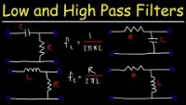
High pass filter– video
  Passive RC low and high pass filter
  https://www.youtube.com/watch?v=lagfhNjMuQM

Slide 15
Task
Calculate the cut-off frequency for the circuit below and state if it is a high pass or low pass filter.
10k
10n

Slide 16
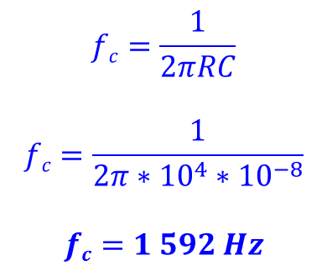
Solution
$$fc=\frac{1}{2πRC}$$
$$fc=\frac{1}{2π∗{10}^{4}∗{10}^{−8}}$$
$$fc=1 592 Hz$$
The cut-off frequency of the circuit is 1 592 Hz.
A signal of the lowest frequency – a DC signal – can‘t pass through the capacitor because there is an insulator between its electrodes.
A signal of a high frequency passes without attenuation because the capacitor represents a short circuit.
The circuit is a high-pass filter.
10k
10n

Slide 17
References
http://www.wikipedia.com
http://www.thefreedictionary.com
http://www.animations.physics.unsw.edu.au/jw/calculus.htm
http://openlearn.open.ac.uk/

