Slide 1


Anglicky v odborných předmětech
"Support of teaching technical subjects in English“
Tutorial: Mechanic – electrician
Topic: Electronics
II.class
Operational Amplifiers:
Inverting Amplifiers – Part 1 - Equations
Prepared by: Ing. Jaroslav Bernkopf
AVOP-ELEKTRO-Ber-002
Projekt Anglicky v odborných předmětech, CZ.1.07/1.3.09/04.0002
je spolufinancován Evropským sociálním fondem a státním rozpočtem České republiky.

Slide 2
Definition:
An inverting amplifier is a circuit, which increases a voltage
while inverting its polarity.
See the example in the figure below:
The input voltage is only 1 V, while the output voltage is 10 V.
The input voltage is positive, while the output is negative.
+1 V
-10 V

Slide 3
Description:
The output polarity of an inverting amplifier is reversed as compared to its input.
If the input voltage is positive, the output voltage is negative, and vice versa.
Input negative, output positive
+1 V
-10 V
Input positive, output negative
-1 V
+10 V

Slide 4
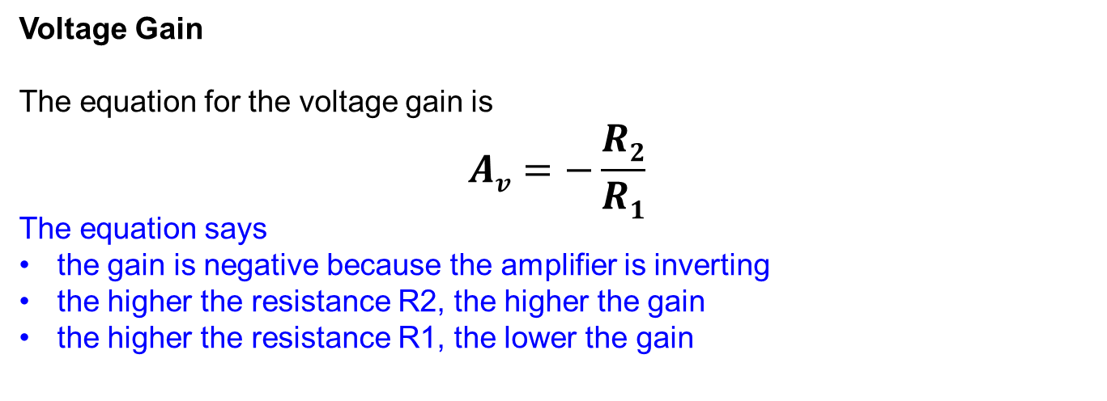
Voltage Gain
The equation for the voltage gain is
$$Av=−\frac{R2}{R1}$$
The equation says
the gain is negative because the amplifier is inverting
the higher the resistance R2, the higher the gain
the higher the resistance R1, the lower the gain

Slide 5
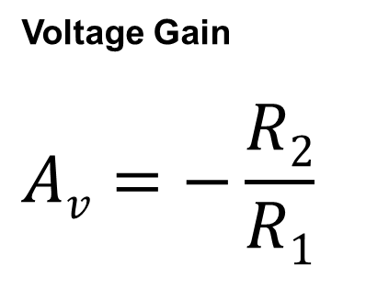
Voltage Gain
$$Av=−\frac{R2}{R1}$$
R2 is on the top, therefore
„The higher ..., the higher ...“
R1 is on the bottom, therefore
„The higher ..., the lower...“

Slide 6
Virtual Ground
We call the node between R1, R2, and V- „Virtual ground“.
It keeps its ground potential without being directly connected to the ground.
The negative feedback ensures that the voltage difference between the inputs V+ and V- is zero.
There is no voltage, no signal in this node.
Virtual ground
V-
V+

Slide 7
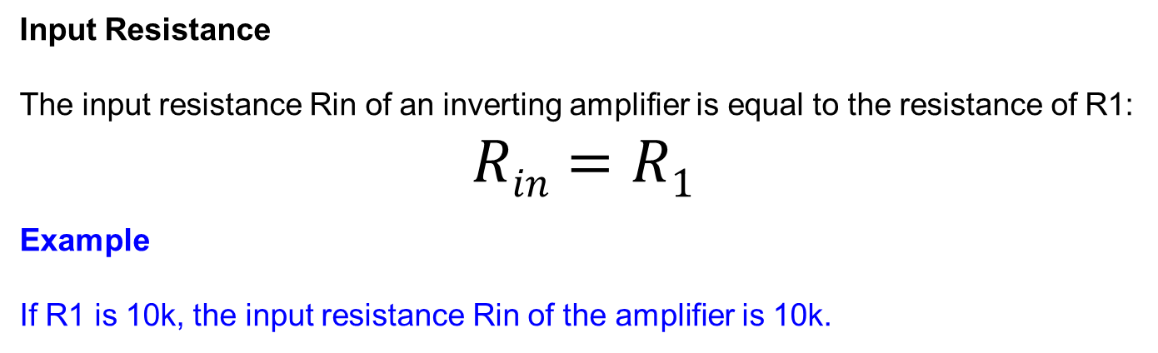
Input Resistance
The input resistance Rin of an inverting amplifier is equal to the resistance of R1:
$$Rin=R1$$
Example
If R1 is 10k, the input resistance Rin of the amplifier is 10k.
Rin
V-
10k
V+

Slide 8
Task
See the figure below.
Given the values of R1, R2, and V1, determine
the polarity and the value of the output voltage V2
the input resistance Rin
100k
V-
V1 = -1.3 V
22k
V+
V2 = ?

Slide 9
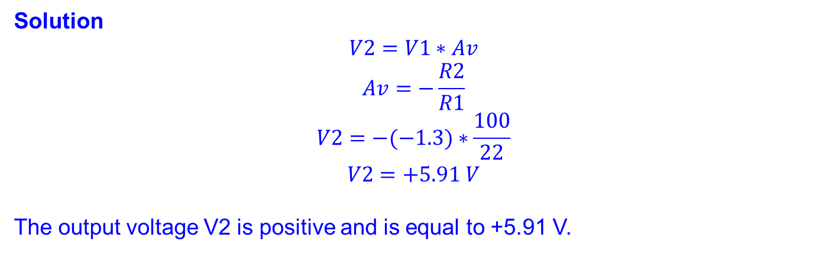
Solution
$$V2=V1∗Av$$
$$Av=−\frac{R2}{R1}$$
$$V2=−(−1.3)∗\frac{100}{22}$$
$$V2=+5.91 V$$
The output voltage V2 is positive and is equal to +5.91 V.
100k
V1 = -1.3 V
22k
V2 = +5.91 V

Slide 10

Solution
$$Rin=R1$$
$$Rin=22k$$
The input resistance Rin is equal to 22 kΩ.
100k
Rin = 22k
V1 = -1.3 V
22k
V2 = +5.91 V

Slide 11
References
http://www.wikipedia.com
http://www.thefreedictionary.com

