Slide 1


Anglicky v odborných předmětech
"Support of teaching technical subjects in English“
Tutorial: Mechanic – electrician
Topic: Electronics
II. class
Operational Amplifiers:
Inverting Amplifiers – Part 2 – Derivations
Prepared by: Ing. Jaroslav Bernkopf
AVOP-ELEKTRO-Ber-003
Projekt Anglicky v odborných předmětech, CZ.1.07/1.3.09/04.0002
je spolufinancován Evropským sociálním fondem a státním rozpočtem České republiky.

Slide 2
Voltage Gain
Do you remember the equation for the voltage gain of an inverting amplifier?
No?
Would you be able to derive it?
No?
Oh yes! You are able to derive it!
Let‘s start!

Slide 3
Voltage Gain
Let‘s apply a voltage V1 of +1 V to the input of the amplifier in the figure.
This voltage will cause a current to flow through the resistor R1.
What will this current be?
We need to know the voltage across the resistor R1 to be able to use the Ohm‘s law to calculate the current.

Slide 4
Voltage Gain
The voltage on the left side of the resistor R1 is +1 V.
What is the voltage on the other side of R1?
The V+ input of the OA1 is grounded, so its voltage is 0.0 V.
The voltage difference between the V+ and V- inputs is zero.
That is why the V- input seems to be grounded too.
It is virtually grounded.
The voltage on the right side of R1 is 0.0 V.
Virtual ground

Slide 5
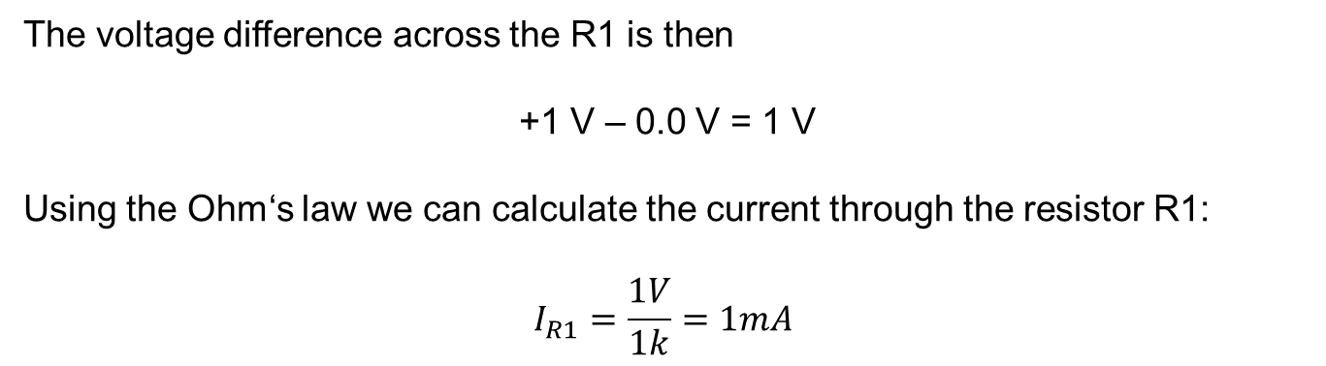
Voltage Gain
The voltage difference across the R1 is then
+1 V – 0.0 V = 1 V
Using the Ohm‘s law we can calculate the current through the resistor R1:
$$I_{R1}=\frac{1V}{1k}=1mA$$
Virtual ground

Slide 6
Voltage Gain
Where does the current continue when leaving the R1?
Can it flow into the input V-?
No, it can‘t, because as we know
the input resistance of OA1 is infinite
the input current of OA1 is zero
So the current from the resistor R1 has to continue towards R2.
Virtual ground

Slide 7
Voltage Gain
The current of 1 mA will create a voltage drop across the resistor R2.
We can calculate it using the Ohm‘s law:
V_{R2} = I_{R2} * R2
V_{R2} = 1mA * 10k
V_{R2} = 10 V
V_{R2} = 10 V
Virtual ground

Slide 8
Voltage Gain
What is the polarity of the voltage drop across R2?
The positive current is being „pumped“ by the voltage V1 = +1 V from the left side of the picture towards the right side.
This is why the left ends of the resistors are more positive than their right ends.
We can draw small plus signs to the left ends, minus signs to the right ends of the resistors.
V_{R2} = 10 V
+
-
Virtual ground
+
-

Slide 9
Voltage Gain
Now, what is the output voltage V2?
The resistor R2 looks like a voltage source having a voltage of 10 V,
with its positive left end „virtually“ grounded.
If its positive left end is grounded, then the other end, which is more negative,
must be „under ground“.
We can conclude that the output voltage V2 is 10 V and negative.
The output voltage V2 is -10 V.
V_{R2} = 10 V
+
-
Virtual ground
+
-
V2 = -10 V

Slide 10
Voltage Gain
What is the voltage gain?
As you can see, the amplifier makes
ten volts out of one volt
negative output voltage out of positive input voltage
Its voltage gain must be -10.
V_{R1} = 1 V
V_{R2} = 10 V
R1 = 1 k
R2 = 10 k
+
-
Virtual ground
+
-
V2 = -10 V

Slide 11
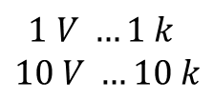
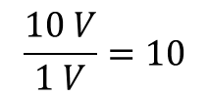
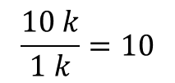
Voltage Gain
Look at the voltages and at the values of the resistors:
$$1 V …1 k$$
$$10 V …10 k$$
$$\frac{10 V}{1 V}=10$$
$$\frac{10 k}{1 k}=10$$
Do the values look so similar just by accident?
V_{R1} = 1 V
V_{R2} = 10 V
R1 = 1 k
R2 = 10 k
+
-
Virtual ground
+
-
V2 = -10 V

Slide 12
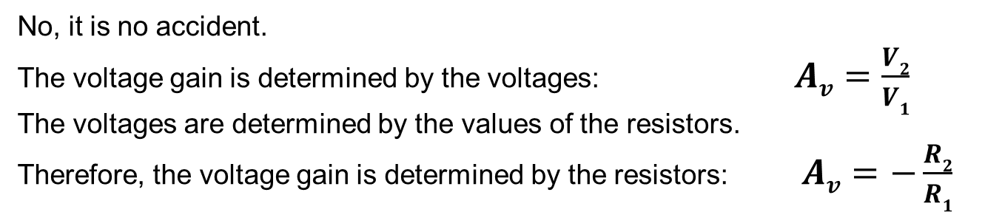
Voltage Gain
No, it is no accident.
The voltage gain is determined by the voltages: $Av=\frac{V2}{V1}$
The voltages are determined by the values of the resistors.
Therefore, the voltage gain is determined by the resistors: $Av=−\frac{R2}{R1}$
V_{R1} = 1 V
V_{R2} = 10 V
R1 = 1 k
R2 = 10 k
+
-
Virtual ground
+
-
V2 = -10 V

Slide 13

Voltage Gain
This is the equation we are looking for:
$$Av=−\frac{R2}{R1}$$
Now you can forget it.
Because in future you will always be able to derive it again.
V_{R1} = 1 V
V_{R2} = 10 V
R1 = 1 k
R2 = 10 k
+
-
Virtual ground
+
-
V2 = -10 V

Slide 14
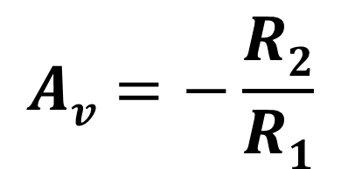
Voltage Gain
We can explain the equation this way:
The smaller the R1, the higher current it passes to R2.
The higher the current, the higher the voltage across R2.
The higher the resistance of R2, the higher the voltage across it.
The higher the voltage across R2, the higher the output voltage.
The higher the output voltage, the higher the voltage gain.
V_{R1} = 1 V
V_{R2} = 10 V
R1 = 1 k
R2 = 10 k
$$Av=−\frac{R2}{R1}$$
+
-
Virtual ground
+
-
V2 = -10 V

Slide 15
Task
Construct the first stage of a preamplifier for record players.
The preamplifier should have the following features:
Input resistance Rin = 47kΩ
Voltage gain Av = - 32
Use the conception shown in the figure below.

Slide 16
Solution
The input resistance of an inverting amplifier is equal to R1.
This implies that R1 must be equal to the desired input resistance Rin.
The resistance of R1 will be 47kΩ.
47k

Slide 17
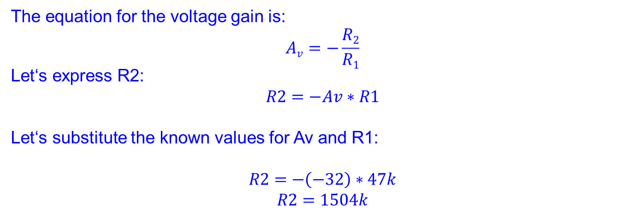
Solution
The equation for the voltage gain is:
$$Av=−\frac{R2}{R1}$$
Let‘s express R2:
$$R2=−Av∗R1$$
Let‘s substitute the known values for Av and R1:
$$R2=−\left(−32\right)∗47k$$
$$R2=1504k$$
The resistance of R2
will be 1500 kΩ = 1.5 MΩ.
1M5
47k

Slide 18
References
http://www.wikipedia.com
http://www.thefreedictionary.com

