Slide 1


Anglicky v odborných předmětech
"Support of teaching technical subjects in English“
Tutorial: Mechanic – electrician
Topic: Electronics
II. class
Operational Amplifiers:
Non-Inverting Amplifiers – Part 1 - Equations
Prepared by: Ing. Jaroslav Bernkopf
AVOP-ELEKTRO-Ber-004
Projekt Anglicky v odborných předmětech, CZ.1.07/1.3.09/04.0002
je spolufinancován Evropským sociálním fondem a státním rozpočtem České republiky.

Slide 2
Definition
A non-inverting amplifier is a circuit, which increases a voltage while maintaining its polarity. The output voltage changes in the same direction as the input voltage.
See the example in the figure below:
The input voltage is only 1 V, while the output voltage is 11 V.
The input voltage is positive, and the output is positive, too.
V+
+1 V
V-
+11 V

Slide 3
Description
The output polarity of a non-inverting amplifier is the same as the input polarity.
If the input voltage is positive, the output voltage is positive, too.
If the input voltage is negative, the output voltage is negative, too.
Input positive, output positive
Input negative, output negative
V+
+1 V
V+
V-
+11 V
-1 V
V-
-11 V

Slide 4
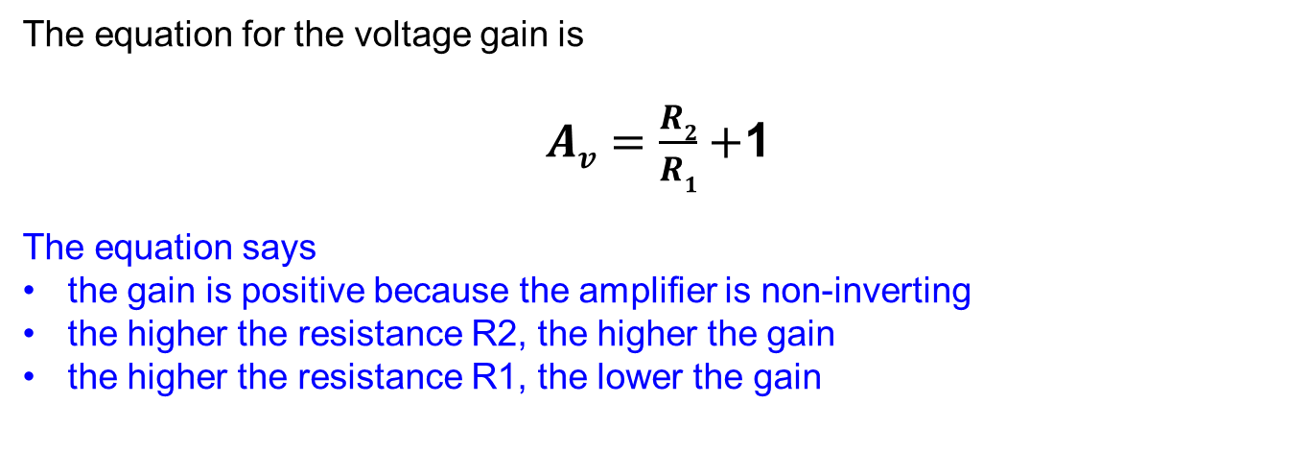
Voltage Gain
The equation for the voltage gain is
$Av=\frac{R2}{R1}+$1
The equation says
the gain is positive because the amplifier is non-inverting
the higher the resistance R2, the higher the gain
the higher the resistance R1, the lower the gain
V+
+1 V
V-
+11 V

Slide 5
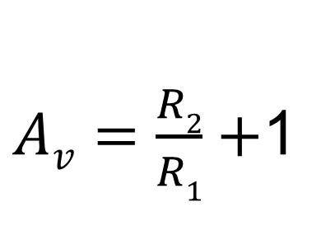
Voltage Gain
$Av=\frac{R2}{R1}+$1
R2 is on the top, therefore
„The higher ..., the higher ...“
The voltage gain is never lower than 1
R1 is on the bottom, therefore
„The higher ..., the lower...“
V+
+1 V
V-
+11 V

Slide 6
Virtual Short
The negative feedback ensures that the non-inverting and inverting inputs of the operational amplifier match.
The inputs seem to be shorted.
The node between R1, R2, and V- keeps the same potential as the input V+.
The signal at the inverting input is the same as that at the non-inverting input.
The signal at the inverting input follows the signal at the non-inverting input.
V+
+1 V
V-
+11 V
Virtual short
+1 V

Slide 7
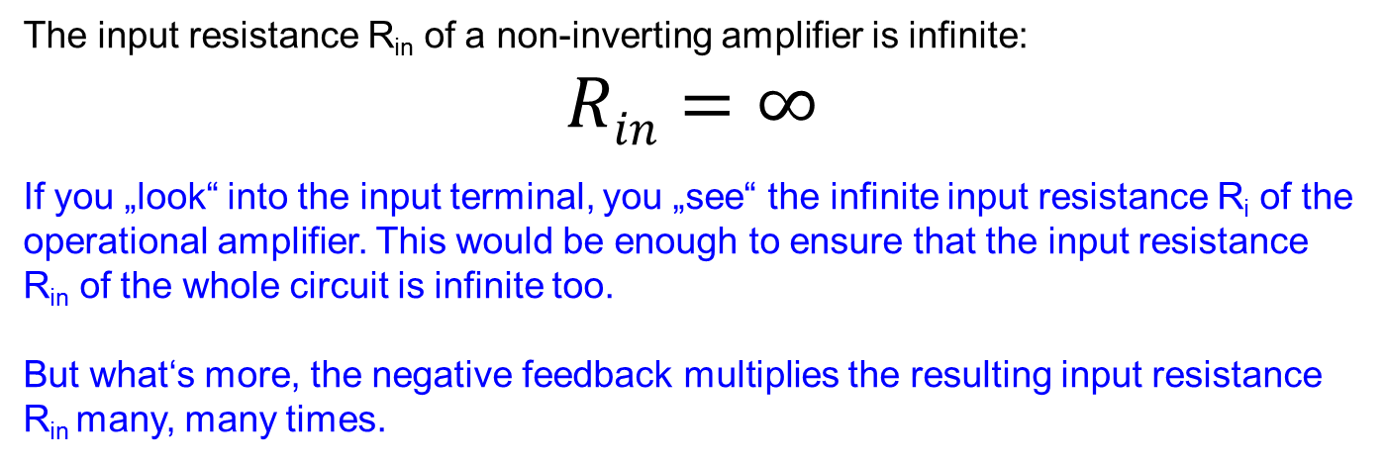
Input Resistance
The input resistance R_{in} of a non-inverting amplifier is infinite:
$$Rin=∞$$
If you „look“ into the input terminal, you „see“ the infinite input resistance R_{i} of the operational amplifier. This would be enough to ensure that the input resistance R_{in} of the whole circuit is infinite too.
But what‘s more, the negative feedback multiplies the resulting input resistance R_{in} many, many times.
Ri = ∞
Rin
V+
+1 V
V-
+11 V
Virtual short
+1 V

Slide 8
Task
See the figure below.
Given the values of R1, R2, and V1, determine
the polarity and the value of the output voltage V2
the input resistance R_{in}
Ri = ∞
Rin = ?
V+
V1 = -1.3 V
V-
V2 = ?
100k
Virtual short
22k

Slide 9
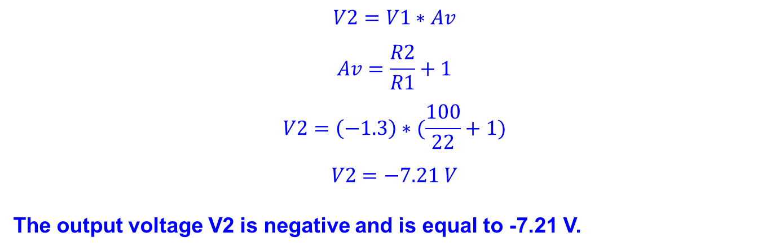
Solution
$$V2=V1∗Av$$
$$Av=\frac{R2}{R1}+1$$
$$V2=\left(−1.3\right)∗(\frac{100}{22}+1)$$
$$V2=−7.21 V$$
The output voltage V2 is negative and is equal to -7.21 V.
Ri = ∞
Rin = ?
V+
V1 = -1.3 V
V-
V2 = -7.21 V
100k
Virtual short
22k

Slide 10

Solution
$$Rin=∞$$
The input resistance R_{in} is (practically) infinite.
Ri = ∞
Rin = ∞
V+
V1 = -1.3 V
V-
V2 = -7.21 V
100k
Virtual short
22k

Slide 11
References
http://www.wikipedia.com
http://www.thefreedictionary.com
http://holbert.faculty.asu.edu/eee202/EEE202_Lect8_OperationalAmplifiers.ppt
http://www.wisc-online.com/Objects/ViewObject.aspx?ID=SSE2803

