Slide 1
Anglicky v odborných předmětech "Support of teaching technical subjects in English“
Tutorial: Mechanic -electrician
Topic: Electronics
II. class
Operational Amplifiers:
Comparators – Part 2 - Hysteresis
Prepared by: Ing. Jaroslav Bernkopf
AVOP-ELEKTRO-Ber-012
Projekt Anglicky v odborných předmětech, CZ.1.07/1.3.09/04.0002
je spolufinancován Evropským sociálním fondem a státním rozpočtem České republiky.

Slide 2
Definition
Hysteresis is the dependence of a circuit not only on its present state but also on its past state.
A comparator without hysteresis has only one switching level.
A comparator with hysteresis has two switching levels.
When the input signal goes upwards, the comparator uses the upper switching level.
When the input signal goes downwards, the comparator uses the lower switching level.

Slide 3
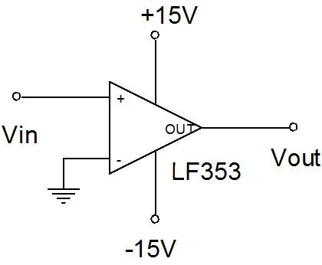
Description
A comparator without hysteresis has only one switching level.

Slide 4
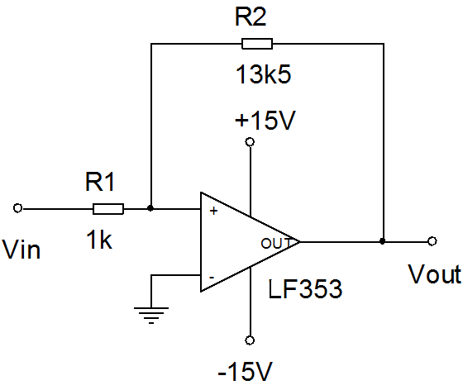
Description
A comparator with hysteresis has two switching levels.

Slide 5
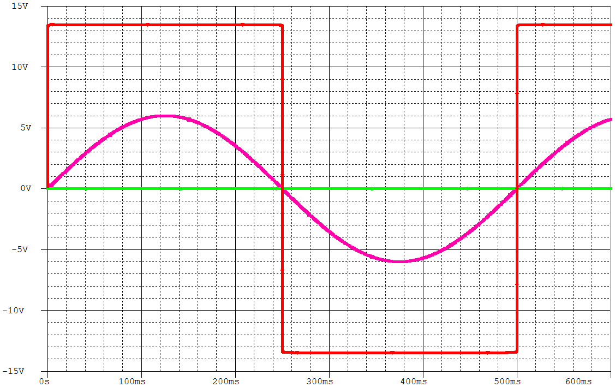
Description
If we want to convert a clean sinusoidal input signal to a rectangular shape, a comparator without hysteresis is OK. The output voltage is clean.
V_{out}
V_{in}

Slide 6
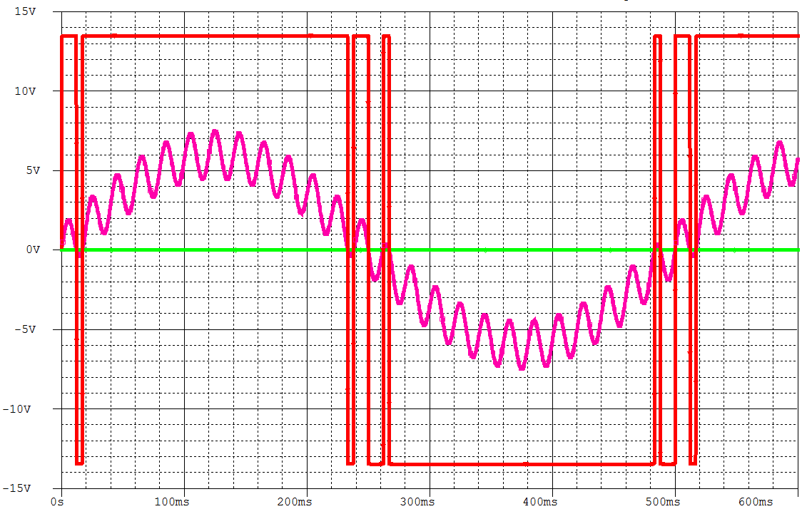
Description
But if the input signal is distorted with noise, the output rectangular signal of a comparator without hysteresis is unusable.
V_{out}
V_{in}

Slide 7
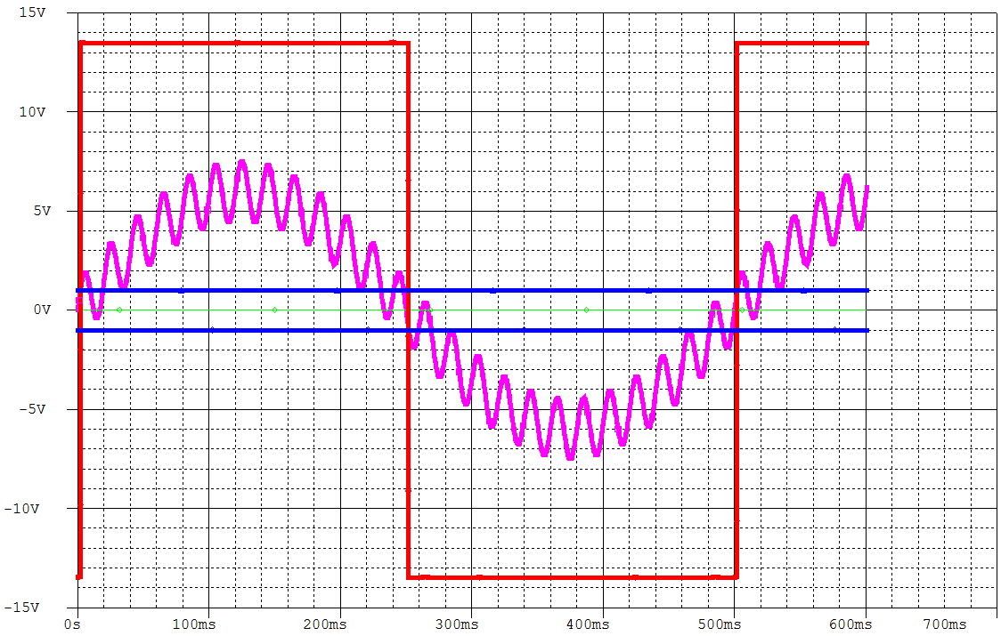
Description
If we use a comparator with hysteresis, the output rectangular signal is clean.
V_{out}
V_{in}

Slide 8
Description
The resistors R1 and R2 introduce a small amount of positive feedback. Due to this feedback the comparator
switches at about +1V when the input signal is going up, and at about -1V when the input is going down.

Slide 9
Task
In the above explanations we used a non-inverting comparator.
Try to draw an inverting comparator with a similar hysteresis.
Non-inverting ↓ Inverting

Slide 10
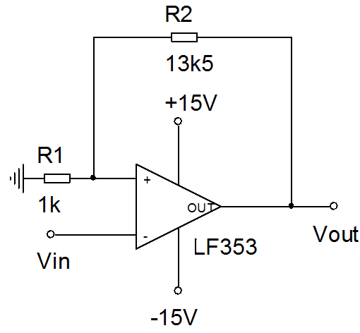
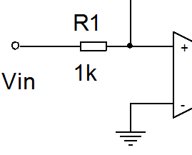
Solution
It is simple, isn‘t it?
Just swap the input terminal and the ground.

Slide 11
References
http://www.wikipedia.com
http://www.thefreedictionary.com
http://holbert.faculty.asu.edu/eee202/EEE202_Lect8_OperationalAmplifiers.ppt
http://www.wisc-online.com/Objects/ViewObject.aspx?ID=SSE2803

