Slide 1


Anglicky v odborných předmětech
"Support of teaching technical subjects in English“
Tutorial: Mechanic – electrician
Topic: Electronics
II. class
Operational Amplifiers:
Integrator
Prepared by: Ing. Jaroslav Bernkopf
AVOP-ELEKTRO-Ber-006
Projekt Anglicky v odborných předmětech, CZ.1.07/1.3.09/04.0002
je spolufinancován Evropským sociálním fondem a státním rozpočtem České republiky.

Slide 2
Definition
An integrator is an electronic circuit, which performs integration.
Integration is a mathematical operation taught in universities.
V-
V+

Slide 3
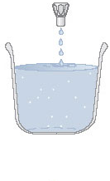
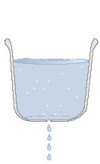
Description
A bucket integrates water flowing into it from a tap ...
... and / or leaking out of it through a hole.
The water level indicates how much water has been integrated in the bucket.

Slide 4
Description
A capacitor integrates electric charge flowing in the form of an electric current
into it ... ... or out of it.
The charge is forced to flow in or out by the input voltage V1.
The charge flows through the resistor R.
The output voltage V2 indicates how much water charge has been integrated in the bucket capacitor.

Slide 5
Description
An integrator integrates electric charge flowing into it or out of it in the form of an electric current.
The charge is forced to flow in or out by the input voltage V1.
The charge flows through the resistor R1.
The output voltage V2 indicates how much water charge has been integrated in the bucket integrator.
V-
V+

Slide 6
Function
Let‘s suppose that in the beginning the capacitor C is empty.
Its left end is „virtually grounded“.
The voltage across the capacitor is zero.
This implies that the output voltage V2 is zero too: 0.0 V + 0.0 V = 0.0 V
V1
V_{C} = 0.0 V
0 V
t
V1 = 0.0 V
Virtual ground
V2
V1 = 0.0 V
V-
0 V
V+
V2 = 0.0 V
t
V2 = 0.0 V

Slide 7
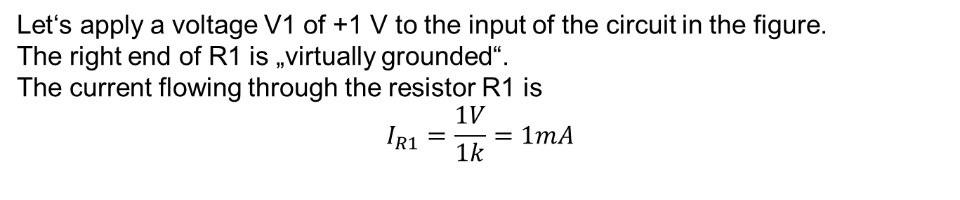
Function
Let‘s apply a voltage V1 of +1 V to the input of the circuit in the figure.
The right end of R1 is „virtually grounded“.
The current flowing through the resistor R1 is
$$I_{R1}=\frac{1V}{1k}=1mA$$
V1
+1 V
V_{C} = ?
0 V
t
Virtual ground
V2
V1 = 1 V
V-
I_{R1} = 1 mA
0 V
V+
V2 = ?
t
V2 = ?

Slide 8
Function
Where does the current continue when leaving the R1?
It can‘t flow into the input V+.
So the current from the resistor R1 has to continue into the capacitor C.
V1
+1 V
V_{C} = ?
0 V
t
I_{C} = 1 mA
V2
V1 = 1 V
V-
I_{R1} = 1 mA
0 V
V+
V2 = ?
t
V2 = ?

Slide 9
Function
The current I_{C} of 1 mA charges the capacitor C.
The voltage V_{C} on the capacitor C is increasing.
V1
+1 V
V_{C} is increasing
0 V
t
I_{C} = 1 mA
V2
V1 = 1 V
V-
I_{R1} = 1 mA
0 V
V+
V2 = ?
t
V2 = ?

Slide 10
Function
What is the polarity of the voltage drop across the capacitor C?
The positive current is being „pumped“ by the voltage V1 = +1 V from the left side of the picture towards the right side.
This is why the left ends of the components are more positive than their right ends.
We can draw positive polarity markings to the left ends, negative polarity markings to the right ends of the components.
V1
+1 V
V_{C} is increasing
0 V
t
+
-
I_{C} = 1 mA
V2
V1 = 1 V
+
-
V-
I_{R1} = 1 mA
0 V
V+
V2 = ?
t
V2 = ?

Slide 11
Function
Now, what is the output voltage V2?
The positive left end of the capacitor C is „virtually“ grounded.
Then the right end, which is more negative, must be „under ground“.
The output voltage V2 is falling and becomes more and more negative.
V1
+1 V
V_{C} is increasing
0 V
t
+
-
Virtual ground
I_{C} = 1 mA
V2
V1 = 1 V
+
-
V-
I_{R1} = 1 mA
0 V
V+
V2 is falling
t
V2 is falling

Slide 12
Function
Let‘s change the voltage V1 to 0.0 V.
No current is flowing through R1.
No current is flowing into the capacitor C.
The capacitor C is neither charging nor discharging. Its voltage doesn‘t change.
The voltage V2 remains steady.
V1
+1 V
V_{C} doesn‘t change
0 V
t
+
-
I_{C} = 0.0 mA
V2
V1 = 0.0 V
V-
I_{R1} = 0.0 mA
0 V
V+
V2 remains steady
t
V2 remains steady

Slide 13
Function
Let‘s change the voltage V1 to -1 V.
The current through R1 is flowing in the opposite direction now.
The capacitor C is discharging. Its voltage is decreasing. But it still keeps its polarity: positive on the left and negative on the right.
The voltage V2 is rising towards the zero level.
V1
+1 V
V_{C} is decreasing
0 V
t
+
-
-1 V
I_{C} = -1 mA
V2
V1 = -1 V
-
+
V-
I_{R1} = -1 mA
0 V
V+
V2 is rising
t
V2 is rising towards zero

Slide 14
Function
The capacitor C is still discharging. Its voltage is decreasing.
When the capacitor C is totally discharged, its voltage V_{C} = 0.0 V.
The voltage V2 reaches the zero level.
V1
+1 V
V_{C} = 0.0 V
0 V
t
-1 V
I_{C} = -1 mA
V2
V1 = -1 V
-
+
V-
I_{R1} = -1 mA
0 V
V+
V2 is rising
t
V2 reaches zero

Slide 15
Function
The voltage across the capacitor C changes its polarity.
Now the capacitor C is being charged to reverse polarity.
Notice that its polarity markings are now reversed – the plus sign being on the right and minus on the left.
The voltage V2 crosses the zero level and keeps rising.
V1
+1 V
V_{C} is increasing
0 V
t
-
+
-1 V
I_{C} = -1 mA
V2
V1 = -1 V
-
+
V-
I_{R1} = -1 mA
0 V
V+
V2 is rising
t
V2 crosses zero

Slide 16
Conclusion
If the input voltage V1 is
positive, the output voltage V2 falls down
negative, the output voltage V2 rises up
zero, the output voltage V2 remains constant
V1
+1 V
0 V
t
-1 V
1
3
V2
2
V-
0 V
V+
t

Slide 17
Task
Refer to the figure below.
Using the given values of the components determine the input resistance R_{in} of the circuit.
10n
R_{in} = ?
22k

Slide 18
Solution
Nothing else than the resistor R1 is connected to the input pin.
All current flowing into the input pin must flow through R1.
The right end of R1 is „virtually grounded“.
The input resistance must be equal to R1.
The input resistance is equal to 22 kΩ.
What about the capacitor C? Doesn‘t it affect the input resistance?
No.
From the point of view of the input pin everything except R1 is hidden behind the virtual ground.
Virtual ground
10n
Rin = 22k
22k

Slide 19
References
http://www.wikipedia.com
http://www.thefreedictionary.com
http://www.animations.physics.unsw.edu.au/jw/calculus.htm
http://openlearn.open.ac.uk/
http://terpconnect.umd.edu/~toh/ElectroSim/Integrator.html

