Slide 1


Anglicky v odborných předmětech
"Support of teaching technical subjects in English“
Tutorial: Mechanic -electrician
Topic: Electronics
II. class
Transistors:
Transistor CE Amplifier
Prepared by: Ing. Jaroslav Bernkopf
AVOP-ELEKTRO-Ber-009
Projekt Anglicky v odborných předmětech, CZ.1.07/1.3.09/04.0002
je spolufinancován Evropským sociálním fondem a státním rozpočtem České republiky.

Slide 2
Definition
A transistor common emitter amplifier is a circuit where the input signal is applied between the base and the emitter while the output is taken from between the collector and the emitter.
The emitter is grounded and is common to both the input and output.
Hence the name: Common emitter amplifier.

Slide 3
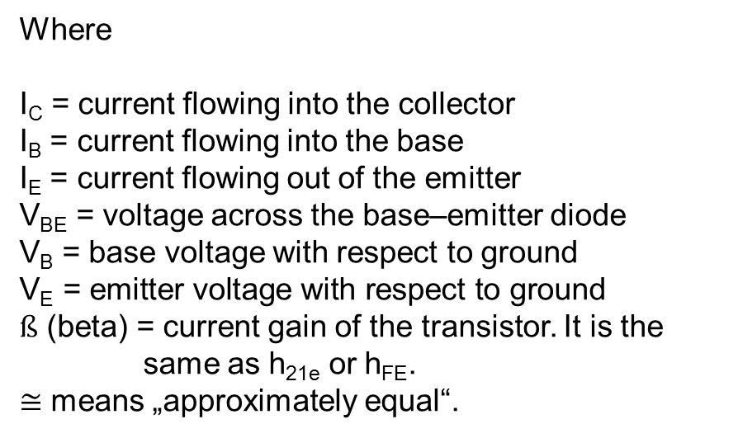
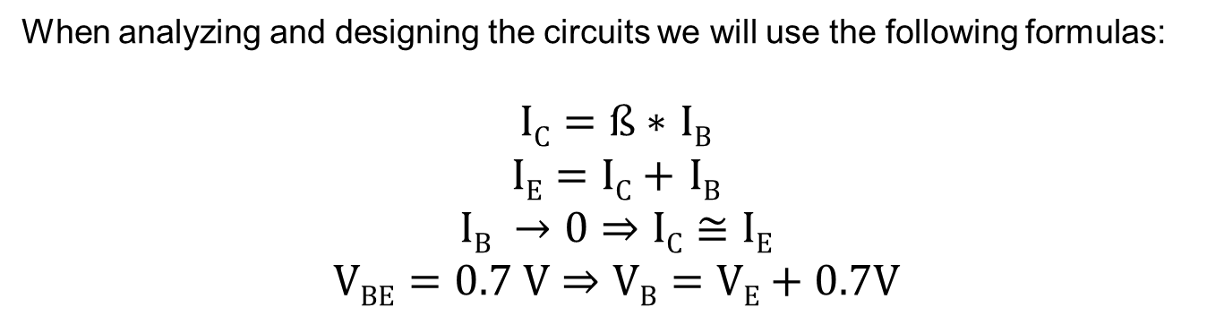
Description
When analyzing and designing the circuits we will use the following formulas:
$IC=ß∗$ $IB$
$IE=IC+$ $IB$
$$IB →0⇒IC≅IE$$
$$VBE=0.7 V⇒VB=VE+0.7V$$
Where
I_{C} = current flowing into the collector
I_{B} = current flowing into the base
I_{E} = current flowing out of the emitter
V_{BE} = voltage across the base–emitter diode
V_{B} = base voltage with respect to ground
$$\text{V}\text{E}\text{ = }\text{emitter} \text{voltage} \text{with} \text{respect} \text{to} \text{ground}$$
$ß$ (beta) = current gain of the transistor. It is the same as h_{21e} or h_{FE}.
$≅$ means „approximately equal“.

Slide 4
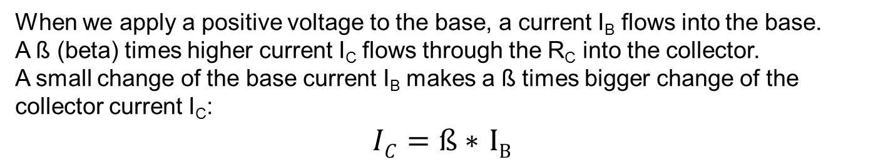
Description
When we apply a positive voltage to the base, a current I_{B} flows into the base.
A ß (beta) times higher current I_{C} flows through the R_{C} into the collector.
A small change of the base current I_{B} makes a ß times bigger change of the collector current I_{C}:
$IC=ß∗$ $IB$

Slide 5
Description
The collector current I_{C} creates a voltage drop V_{RC} across the collector resistor R_{C}.
The higher the base voltage, the bigger the voltage drop V_{RC}, and the lower the collector voltage V_{out}.
An increase in base input voltage V_{in} causes a decrease in collector output voltage V_{out}.
This is why we call this circuit an "Inverting Amplifier“.
A small change of the base voltage makes a big change of the collector voltage.
The input signal applied on the base appears, amplified, on the collector.
V_{RC}
V_{CC}
V_{out}

Slide 6
Task
All bias components have been omitted to simplify the above explanations.
In the next task, we will design a real amplifier stage including the setting and stabilization of the operating point.
The operating point of a transistor, also known as bias point, quiescent point, or Q-point, is the steady-state operating condition of a transistor with no input signal applied.
(Wikipedia)
R_{E}

Slide 7
Task
Given the following conditions, calculate the values of all resistors for the circuit below.
I_{C} = 1 mA
V_{CE} = 5 V
V_{E} = 2 V
ß ≥ 100
Current I_{R1R2} through the voltage divider R₁, R₂ about 10 times the max I_{B}
I_{R1R2}
I_{C}=1mA
V_{CE}=5V
R_{E}
V_{E}=2V

Slide 8
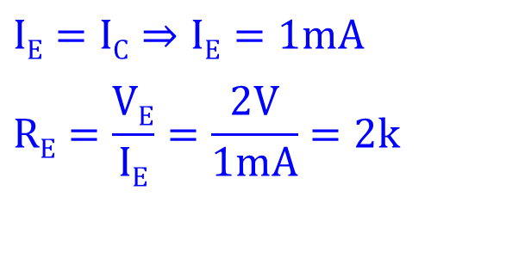
Solution
$$IE=IC⇒IE=1mA$$
$$RE=\frac{VE}{IE}=\frac{2V}{1mA}=2k$$
I_{R1R2}
I_{C}=1mA
V_{CE}=5V
I_{E}=1mA
2k
R_{E}
V_{E}=2V

Slide 9
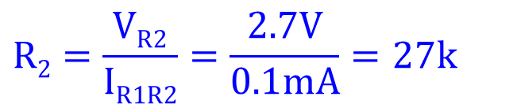
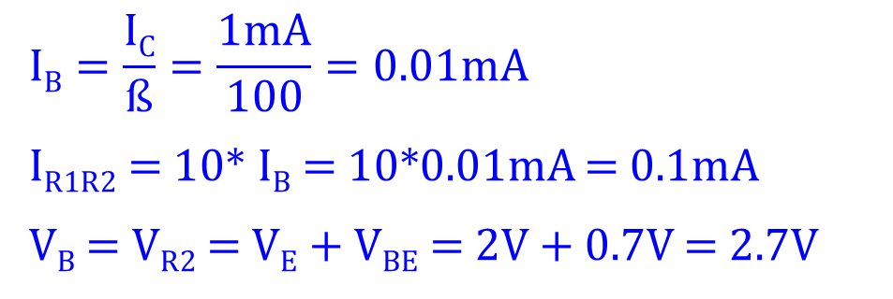
Solution
$$IB=\frac{IC}{ß}=\frac{1mA}{100}=0.01mA$$
I_{R1R2} = 10* I_{B} = 10*0.01mA = 0.1mA
V_{B} = V_{R2} = V_{E} + V_{BE} = 2V + 0.7V = 2.7V
$$R2=\frac{VR2}{IR1R2}=\frac{2.7V}{0.1mA}=27k$$
I_{R1R2}
I_{C}=1mA
V_{CE}=5V
I_{E}=1mA
V_{B} = V_{R2} = 2.7 V
2k
R_{E}
V_{E}=2V
27k

Slide 10
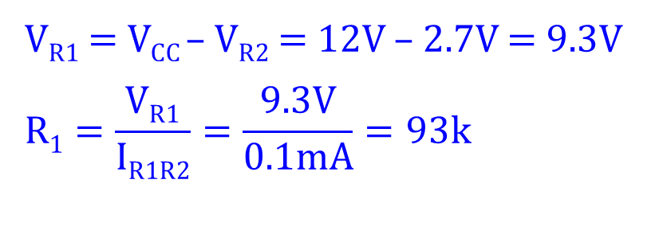
Solution
V_{R1} = V_{CC} – V_{R2} = 12V – 2.7V = 9.3V
$$R1=\frac{VR1}{IR1R2}=\frac{9.3V}{0.1mA}=93k$$
93k
V_{R1} = 9.3 V
I_{R1R2}
I_{C}=1mA
V_{CE}=5V
I_{E}=1mA
V_{B} = V_{R2} = 2.7 V
2k
R_{E}
V_{E}=2V
27k

Slide 11
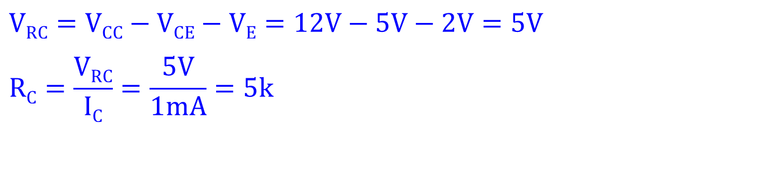
Solution
$$VRC=\text{V}\text{CC}−\text{V}\text{C}E−\text{V}\text{E}=12V−5V−2V=5V$$
$$RC=\frac{VRC}{IC}=\frac{5V}{1mA}=5k$$
V_{R1} = 9.3 V
93k
5k
V_{RC}=5V
I_{R1R2}
I_{C}=1mA
V_{CE}=5V
I_{E}=1mA
V_{CC}=12V
V_{B} = V_{R2} = 2.7 V
2k
R_{E}
V_{E}=2V
27k

Slide 12
Solution
When solving the task we have only needed three simple rules:
Ohm‘s law
Kirchhoff‘s voltage law
Kirchhoff‘s current law
V_{R1} = 9.3 V
93k
5k
V_{RC}=5V
I_{R1R2}
I_{C}=1mA
V_{CE}=5V
I_{E}=1mA
V_{CC}=12V
V_{B} = V_{R2} = 2.7 V
2k
R_{E}
V_{E}=2V
27k

Slide 13
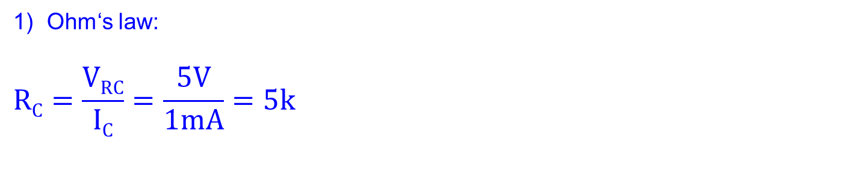
Solution
Ohm‘s law:
$$RC=\frac{VRC}{IC}=\frac{5V}{1mA}=5k$$
V_{R1} = 9.3 V
93k
5k
V_{RC}=5V
I_{R1R2}
I_{C}=1mA
V_{CE}=5V
I_{E}=1mA
V_{CC}=12V
V_{B} = V_{R2} = 2.7 V
2k
R_{E}
V_{E}=2V
27k

Slide 14
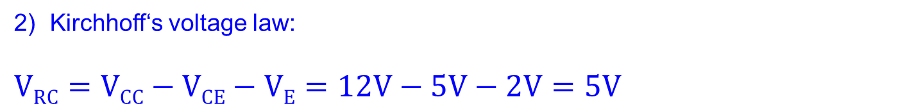
Solution
Kirchhoff‘s voltage law:
$$VRC=\text{V}\text{CC}−\text{V}\text{C}E−\text{V}\text{E}=12V−5V−2V=5V$$
V_{R1} = 9.3 V
93k
5k
V_{RC}=5V
I_{R1R2}
I_{C}=1mA
V_{CE}=5V
I_{E}=1mA
V_{CC}=12V
V_{B} = V_{R2} = 2.7 V
2k
R_{E}
V_{E}=2V
27k

Slide 15
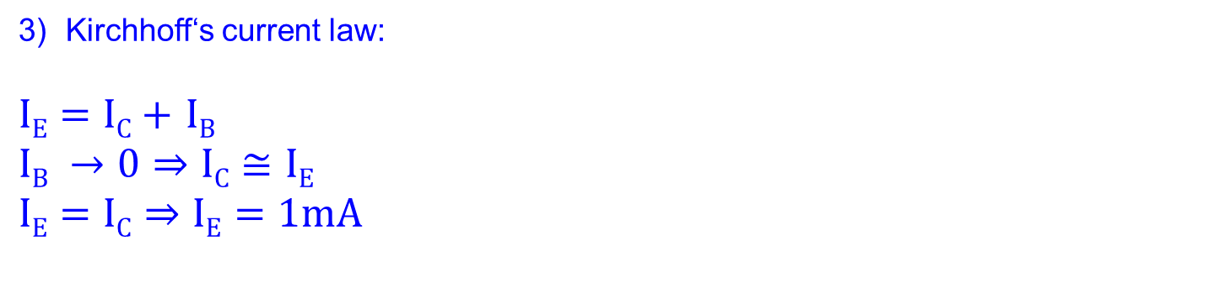
Solution
Kirchhoff‘s current law:
$IE=IC+$ $IB$
$$IB →0⇒IC≅IE$$
$$IE=IC⇒IE=1mA$$
V_{R1} = 9.3 V
93k
5k
V_{RC}=5V
I_{R1R2}
I_{C}=1mA
V_{CE}=5V
I_{E}=1mA
V_{CC}=12V
V_{B} = V_{R2} = 2.7 V
2k
R_{E}
V_{E}=2V
27k

Slide 16
References
http://en.wikipedia.org/wiki/Common_emitter
http://www.thefreedictionary.com
http://www.animations.physics.unsw.edu.au/jw/calculus.htm
http://openlearn.open.ac.uk/
http://www.dnatechindia.com/Tutorial/Transistors/Bipolar-Transistor.html
http://talkingelectronics.com/pay/TEI-Index-Full.html

