Slide 1


Anglicky v odborných předmětech
"Support of teaching technical subjects in English“
Turorial: Mechanic – electrician
Topic: Electronics
II. class
Transistors:
Transistor CE Switch
Prepared by: Ing. Jaroslav Bernkopf
AVOP-ELEKTRO-Ber-010
Projekt Anglicky v odborných předmětech, CZ.1.07/1.3.09/04.0002
je spolufinancován Evropským sociálním fondem a státním rozpočtem České republiky.

Slide 2
Definition
A transistor common emitter switch is a circuit where the input signal on the base switches on or off the current to the load, which is connected between the collector and the power supply.
A small base current controls a much larger collector load current.
The emitter is grounded.
... is equal to ...

Slide 3
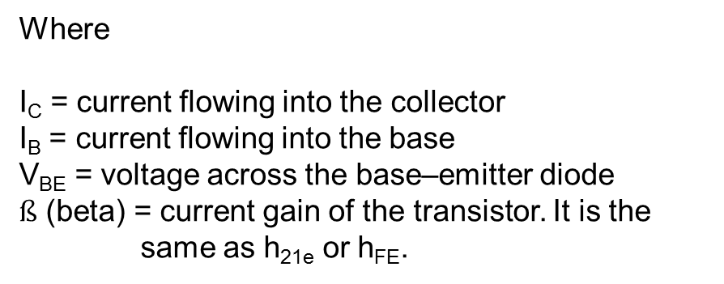
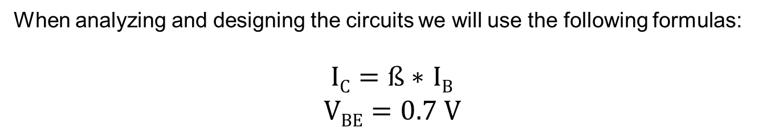
Description
When analyzing and designing the circuits we will use the following formulas:
$IC=ß∗$ $IB$
$$VBE=0.7 V$$
Where
I_{C} = current flowing into the collector
I_{B} = current flowing into the base
V_{BE} = voltage across the base–emitter diode
$ß$ (beta) = current gain of the transistor. It is the same as h_{21e} or h_{FE}.

Slide 4
Description
When there is no voltage and no current applied to the base, no current flows through the load.
The transistor is switched off.
Its resistance is infinite.
The load is disconnected.
The transistor in this state is equal to an open switch.
... is equal to ...

Slide 5
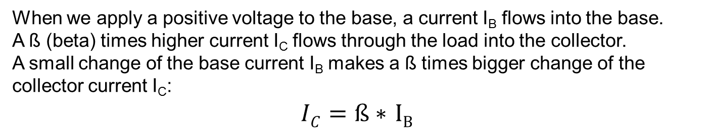
Description
When we apply a positive voltage to the base, a current I_{B} flows into the base.
A ß (beta) times higher current I_{C} flows through the load into the collector.
A small change of the base current I_{B} makes a ß times bigger change of the collector current I_{C}:
$IC=ß∗$ $IB$

Slide 6
Description
The collector current I_{C} creates a voltage drop V_{L} across the load.
The higher the base current, the bigger the voltage drop V_{L}, and the lower the collector voltage V_{C}.
An increase in base current I_{B} causes a decrease in collector voltage V_{C}.
If we keep raising the base current I_{B}, the collector voltage V_{C} falls down to zero.
V_{L}
V_{CC}
V_{C}

Slide 7
Description
When there is an appropriate current applied to the base, full current flows through the load.
The transistor is switched on.
Its resistance is zero.
The load is directly connected to the V_{CC}.
The transistor in this state is equal to a closed switch.
There is no voltage drop between the collector and the emitter.
... is equal to ...

Slide 8
Task
Given the values of the components in the following picture, calculate the value of the resistor R1.
The voltage drop across the LED D1 is 2V.
V_{CC} is equal to 5 V.
74ALS00

Slide 9
Solution
To solve the circuit we will have to know / calculate:
current flowing through the LED and the transistor
current gain of the transistor
base current needed to switch the transistor on
voltage available on the output of the gate
74ALS00

Slide 10
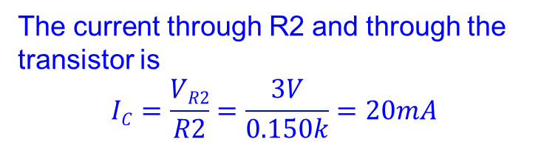
Solution
The current flowing through the LED and the transistor
The voltage drop across the transistor is (or should be) zero.
The voltage drop across the LED is 2V.
The voltage drop across R2 is
V_{R2} = 5V – 2V = 3V
The current through R2 and through the transistor is
$$IC=\frac{VR2}{R2}=\frac{3V}{0.150k}=20mA$$
I_{C}=20mA
74ALS00

Slide 11
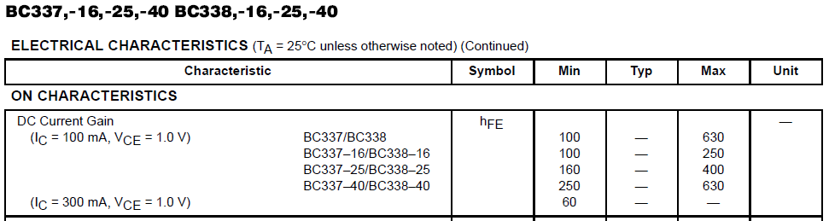
Solution
The current gain of the transistor
The minimum current gain h_{FE} for the transistor BC337-25 is 160.
hFE is the same as ß.
We will use the symbol ß.
I_{C}=20mA

Slide 12
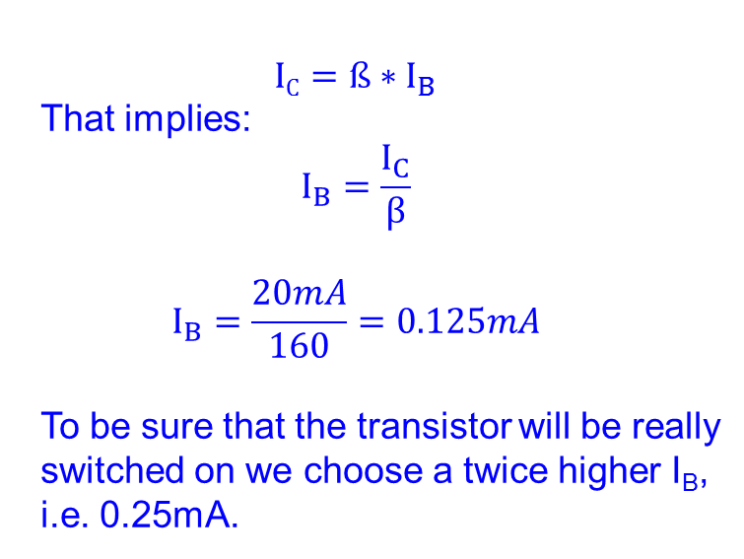
Solution
The base current needed to switch the transistor on
$$IC=ß∗I_{B}$$
That implies:
$$I_{B}=\frac{I_{C}}{β}$$
$$I_{B}=\frac{20mA}{160}=0.125mA$$
To be sure that the transistor will be really switched on we choose a twice higher I_{B}, i.e. 0.25mA.
I_{B}=0.25mA
I_{C}=20mA
74ALS00

Slide 13
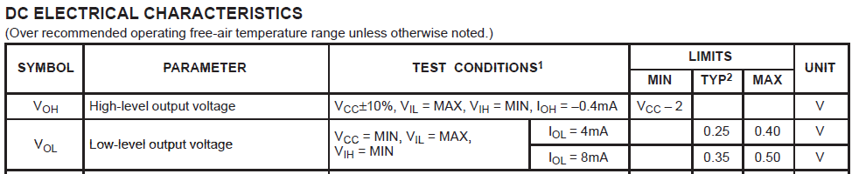
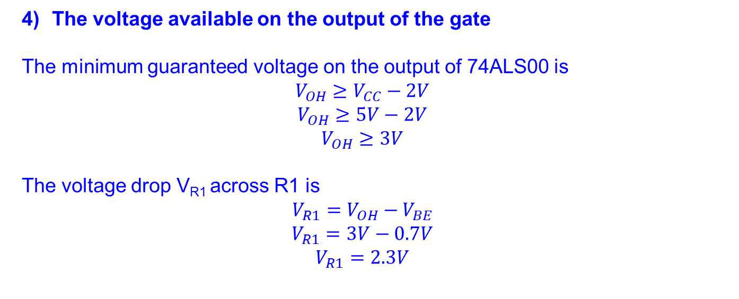
Solution
The voltage available on the output of the gate
The minimum guaranteed voltage on the output of 74ALS00 is
$$V_{OH}≥V_{CC}−2V$$
$$V_{OH}≥5V−2V$$
$$V_{OH}≥3V$$
The voltage drop V_{R1} across R1 is
$$V_{R1}=V_{OH}−V_{BE}$$
$$V_{R1}=3V−0.7V$$
$$V_{R1}=2.3V$$

Slide 14
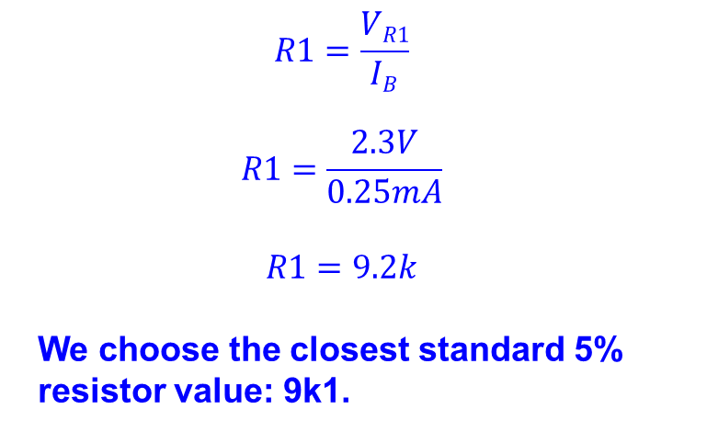
Solution
Using the Ohm‘s law we can now calculate the value of R1:
$$R1=\frac{VR1}{IB}$$
$$R1=\frac{2.3V}{0.25mA}$$
$$R1=9.2k$$
We choose the closest standard 5% resistor value: 9k1.
I_{B}=0.25mA
I_{C}=20mA
9k1
74ALS00

Slide 15
References
http://en.wikipedia.org/wiki/Common_emitter
http://www.thefreedictionary.com
http://www.animations.physics.unsw.edu.au/jw/calculus.htm
http://openlearn.open.ac.uk/
http://www.dnatechindia.com/Tutorial/Transistors/Bipolar-Transistor.html
http://talkingelectronics.com/pay/TEI-Index-Full.html

