Slide 1
Electrical Laws
Ing. Jaroslav Bernkopf

Slide 2
Objectives
Definitions: voltage, current, resistance
Ohm‘s Law
Kirchhoff‘s current law
Kirchhoff‘s voltage law

Slide 3
Vocabulary
English | Czech | English | Czech
apply |  | resistance
battery |  | split
branch |  | sum
circuit |  | the higher, ... the ...
conductor |  | tube
consist of |  | voltage
continuous |  | voltage
current |  | voltage drop
flow
force
in parallel
in series
is equal to
law
measure
motivate
movement
multiplied by
node
on the bottom
on the top
opposition
pass
pressure

Slide 4
Basics
Voltage is the force
motivating electrons to "flow" in a circuit.
Voltage forces electrons to flow.
Voltage is a „force“.

Slide 5
Basics
Current is a continuous movement of free electrons through the conductors.
Current is a movement of electrons.

Slide 6
Basics
Resistance is
the opposition to motion of free electrons.
Resistance is the opposition to motion.

Slide 7
Ohm‘s Law
V is on the top, therefore:
The higher the voltage, the higher the current.
$$I=\frac{V}{R}$$
R is on the bottom, therefore:
The higher the resistance, the lower the current.

Slide 8
Ohm‘s Law
A higher | voltage | forces more | current | through | the resistance.
 | pressure |  | water |  | the tube.
A higher voltage
can force more current through the resistance.
A higher pressure
can force more water through the tube.
$$I=\frac{V}{R}$$

Slide 9
The…the… with comparative adjectives
The more you want, the less you get.
The more I believe it, the more I am happy.
The more you hate me, the more I love you.
The harder you push, the faster it goes.

Slide 10
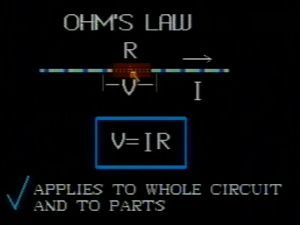
Ohm‘s Law
DC Circuits & Ohm‘s Law
http://www.youtube.com/watch?v=1Oul4S2wfCk

Slide 11
Ohm‘s Law
Ohm‘s Law - Simulation
https://phet.colorado.edu/en/simulation/ohms-law

Slide 12
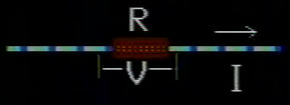
Ohm‘s Law
Here we see a current I
passing through a resistor of resistance R.
The current is passing through the resistor.

Slide 13
Ohm‘s Law
V = I * R
The voltage drop accross the resistor is equal to the current through it multiplied by its resistance.
The voltage is equal to the current multiplied by the resistance.

Slide 14
Ohm‘s Law
V = I * R
The voltage drop is measured in volts.
The current is measured in amperes.
The resistance is measured in ohms.

Slide 15
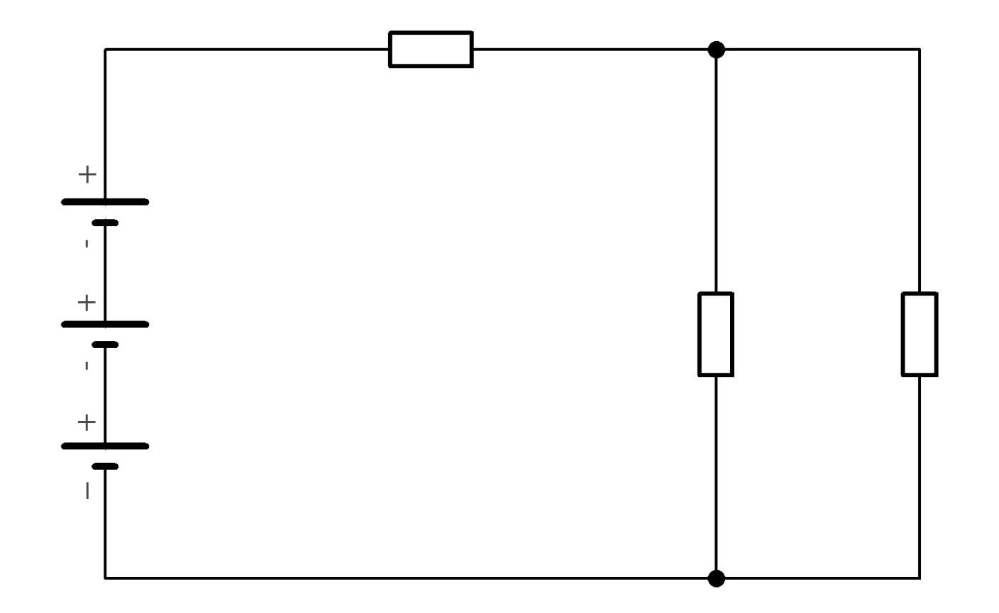
Ohm‘s Law
I
R₃
V₃ = I * R₃
I₁
I₂
R₁
R₂
V₂ = I * R₂
I
Here is a typical DC circuit.
It consists of a battery and
some resistors in series and in parallel.

Slide 16
Ohm‘s Law
I
R₃
V₃ = I * R₃
I₁
I₂
R₁
R₂
V₂ = I * R₂
I
The current I splits
into two branches: I1 and I2.

Slide 17
Ohm‘s Law
I
R₃
V₃ = I * R₃
I₁
I₂
R₁
R₂
V₂ = I * R₂
I
We can apply the Ohm‘s law to the parts of the circuit.

Slide 18
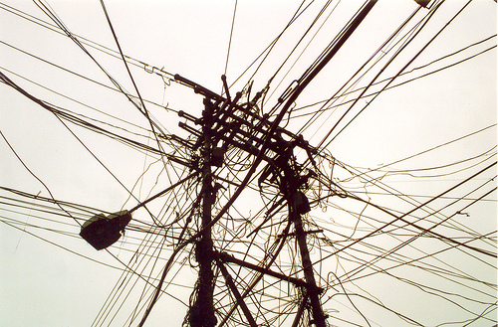
Kirchhoff's current law
The sum of currents flowing into a node is equal to ...
... the sum of currents flowing out of the node.

Slide 19
Kirchhoff's current law
The sum of currents flowing into a node is equal to ...
I
R₃
I₁
I₂
R₁
R₂
I
... the sum of currents flowing out of the node.

Slide 20
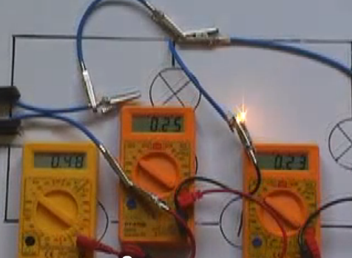
Kirchhoff's current law
Kirchhoff's First Law on current flow
http://www.youtube.com/watch?v=Mc_g26ixTtA

Slide 21
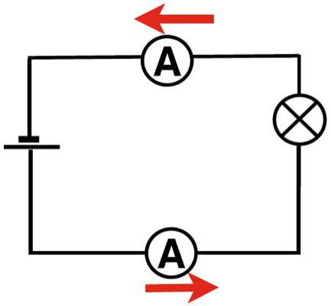
Kirchhoff's current law
Kirchoff’s First Law in a series circuit
In a series circuit the same current flows all the way around. The position of the ammeter is unimportant because it will read the same wherever it is placed.
https://www.fizzics.org/kirchoffs-first-law-notes-and-video/

Slide 22
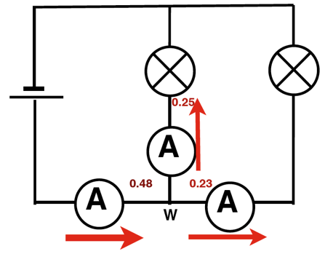
Kirchhoff's current law
Kirchoff’s First Law In a branched circuit
The most often used and complete statement of Kirchoff’s First Law states is that vector sum of the current at any point in a circuit is zero.
Another way of saying this (but not the proper statement is that:
In a series circuit the same current flows all the way around. It does not matter where it is measured it will be the same at every point.
In a branched or parallel circuit the current will split between the branches so that if we add up the current measurement in each branch it will be the same as in the main part of the circuit.
If we use the proper statement to analyse the current in the branched (parallel) circuits below. If the current going into point W is positive and that leaving is negative, then from the circuit here:
0.48 - 0.25 - 0.23 = 0
Watch the video to see these measurements in a more practical way.
https://www.fizzics.org/kirchoffs-first-law-notes-and-video/

Slide 23
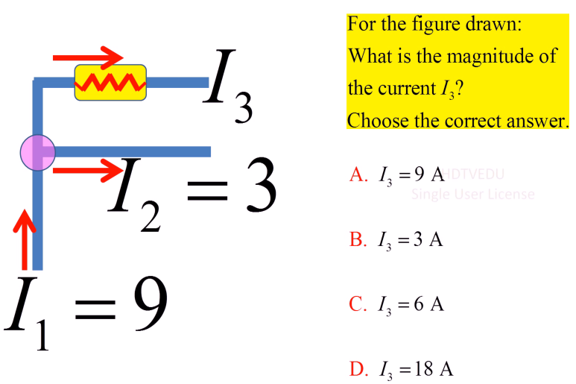
Kirchhoff's current law
Kirchhoff's Current Law
http://www.youtube.com/watch?v=x2fI-ZnNlxY

Slide 24
Crossword

Slide 25
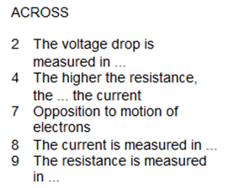
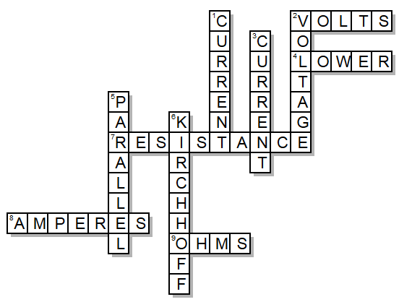
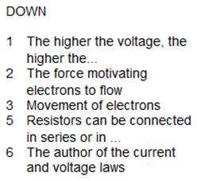
Crossword – solution

Slide 26
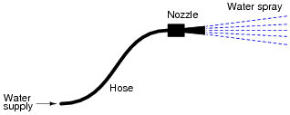
Exercise 1
Question 1
For a given amount of water pressure, which will flow a greater rate of water: a small (restrictive) nozzle or a large (unrestrictive) nozzle? Explain how this relates to the study of voltage, current, and resistance in a simple electric circuit.
https://www.allaboutcircuits.com/worksheets/ohms-law/

Slide 27
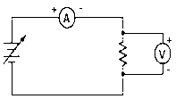
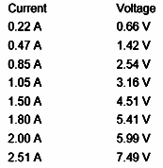
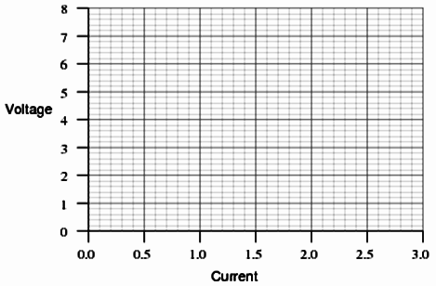
Exercise 1
Question 2
Suppose you were to build this circuit and take measurements of current through the resistor and voltage across the resistor:
Recording these numerical values in a table, the results look something like this:
Plot these figures on the following graph:
What mathematical relationship do you see between voltage and current in this simple circuit?
https://www.allaboutcircuits.com/worksheets/ohms-law/

Slide 28
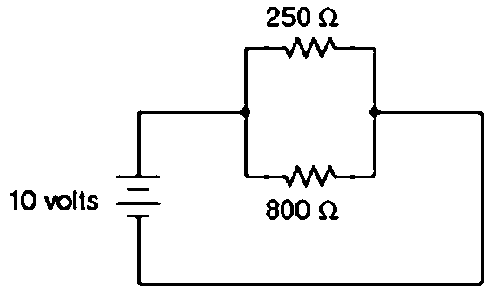
Exercise 1
Question 3
A common saying about electricity is that ït always takes the path of least resistance.” Explain how this proverb relates to the following circuit, where electric current from the battery encounters two alternate paths, one being less resistive than the other:
https://www.allaboutcircuits.com/worksheets/ohms-law/

Slide 29
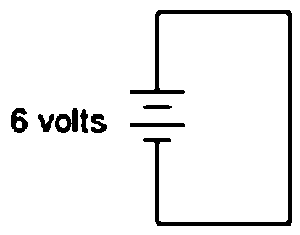
Exercise 1
Question 4
What would happen if a wire having no resistance at all (0 Ω) were connected directly across the terminals of a 6-volt battery? How much current would result, according to Ohm’s Law?
Suppose we were to short-circuit a 6-volt battery in the manner just described and measure 8 amps of current. Why don’t the calculated figures from the previous paragraph agree with the actual measurement?
https://www.allaboutcircuits.com/worksheets/ohms-law/

Slide 30
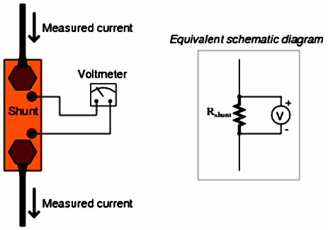
Exercise 1
Question 5
Shunt resistors are often used as current-measuring devices, in that they are designed to drop very precise amounts of voltage as large electric currents pass through them. By measuring the amount of voltage dropped by a shunt resistor, you will be able to determine the amount of current going through it:
Suppose that a shunt resistance is labeled with the following rating: 150 A , 50 mV. What is the resistance of this shunt, in ohms?
https://www.allaboutcircuits.com/worksheets/ohms-law/

Slide 31
Exercise 1
Question 6
A quantity often useful in electric circuit analysis is conductance, defined as the reciprocal of resistance:
$$G= \frac{1}{R}$$
The unit of conductance is the siemens, symbolized by the capital letter “S”. Convert the following resistance values into conductance values:
R = 5 k Ω ; G =
R = 47 Ω ; G =
R = 500 MΩ ; G =
R = 18.2 μΩ ; G =
https://www.allaboutcircuits.com/worksheets/ohms-law/

Slide 32
Exercise 1
Question 7
Suppose an electric current of 1.5 microamps (1.5 μA) were to go through a resistance of 2.3 mega-ohms (2.3 MΩ). How much voltage would be “dropped” across this resistance?
https://www.allaboutcircuits.com/worksheets/ohms-law/

Slide 33
Exercise 1
Question 8
One of the fundamental equations used in electricity and electronics is Ohm’s Law: the relationship between voltage (E or V, measured in units of volts), current (I, measured in units of amperes), and resistance (R, measured in units of ohms):
I = $\frac{V}{R}$
Where,
V = Voltage in units of volts (V)
I = Current in units of amps (A)
R = Resistance in units of ohms (Ω)
Solve for the unknown quantity (V, I, or R) given the other two:
I = 45 mA, R = 3.0 kΩ; V =
I = 10 kA, R = 0.5 mΩ; V =
V = 45 V, R = 4.7 kΩ; I =
V = 13.8 kV, R = 8.1 kΩ; I =
V = 500 μV, I = 36 nA; R =
V = 14 V, I = 110 A; R =
I = 0.001 A, R = 922 Ω; V =
I = 825 A, R = 15.0 mΩ; V =
V = 1.2 kV, R = 30 MΩ; I =
V = 750 mV, R = 86 Ω; I =
V = 30.0 V, I = 0.0025 A; R =
V = 0.00071 V, I = 3389 A; R =
https://www.allaboutcircuits.com/worksheets/ohms-law/

Slide 34
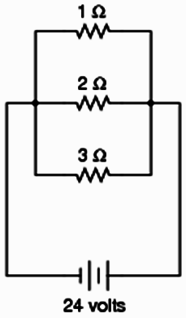
Exercise 1
Question 9
In this circuit, three resistors receive the same amount of voltage (24 volts) from a single source. Calculate the amount of current “drawn” by each resistor, as well as the amount of power dissipated by each resistor:
https://www.allaboutcircuits.com/worksheets/parallel-dc-circuits/

Slide 35
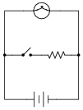
Exercise 1
Question 10
What will happen to the brightness of the light bulb if the switch in this circuit is suddenly closed?
https://www.allaboutcircuits.com/worksheets/parallel-dc-circuits/

Slide 36
Exercise 1
Question 11
The equation for calculating total resistance in a parallel circuit (for any number of parallel resistances) is sometimes written like this:
R_{total} = (R₁⁻¹ + R₂⁻¹ + …R_{n}⁻¹)⁻¹
Re-write this equation in such a way that it no longer contains any exponents:
https://www.allaboutcircuits.com/worksheets/parallel-dc-circuits/

Slide 37
Exercise 1
Question 12
Manipulate this equation to solve for resistor value R₁, given the values of R₂ and R_{p}:
$$RP= \frac{R1 ∗R2}{R1+R2}$$
$$R1= ???$$
Then, give an example of a practical situation where you might use this new equation.
Then, give an example of a practical situation where you might use this new equation.
https://www.allaboutcircuits.com/worksheets/parallel-dc-circuits/

Slide 38
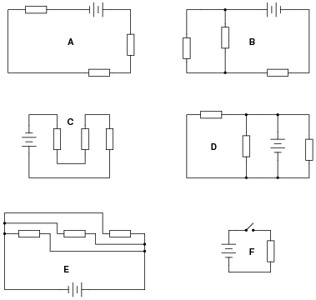
Exercise 1
Question 13
Identify which of these circuits is a "pure" parallel circuit (there may be more than one shown!):
https://www.allaboutcircuits.com/worksheets/parallel-dc-circuits/

Slide 39
Exercise 1
Question 14
Determine the amount of voltage impressed across each resistor in this circuit:
Hint: locate all the points in this circuit that are electrically common to one another!
https://www.allaboutcircuits.com/worksheets/parallel-dc-circuits/

Slide 40
Exercise 1
Question 15
According to Ohm’s Law, how much current goes through each of the two resistors in this circuit?
Draw the paths of all currents in this circuit.
https://www.allaboutcircuits.com/worksheets/parallel-dc-circuits/

Slide 41
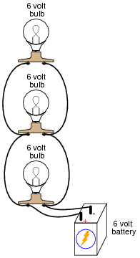
Exercise 1
Question 16
Qualitatively compare the voltage and current for each of the three light bulbs in this circuit (assume the three light bulbs are absolutely identical):
Draw a professional schematic of the circuit.
https://www.allaboutcircuits.com/worksheets/parallel-dc-circuits/

Slide 42
Exercise 1
Question 17
Identify which of these circuits is a "pure" series circuit (there may be more than one shown!):
https://www.allaboutcircuits.com/worksheets/parallel-dc-circuits/

Slide 43
Exercise 1
Question 18
Identify which of these circuits is a combination of a parallel and a series circuit (there may be more than one shown!):
https://www.allaboutcircuits.com/worksheets/parallel-dc-circuits/

Slide 44
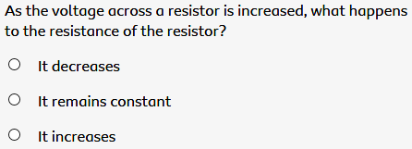
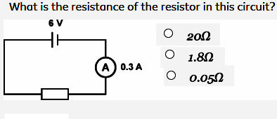
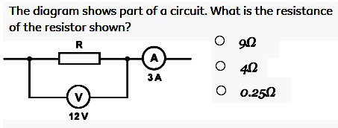
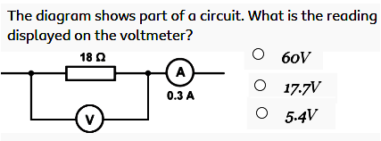
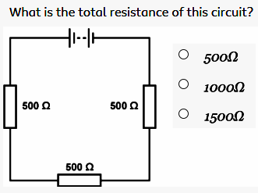
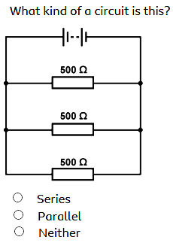
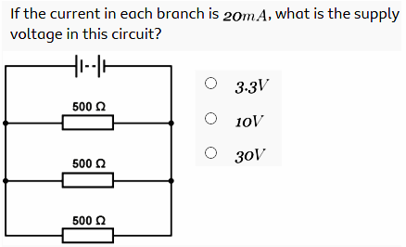
20-5n
E-Laws A | Jméno: | Třída: | Datum:
https://www.bbc.com/bitesize/guides/z8b2pv4/test

Slide 45
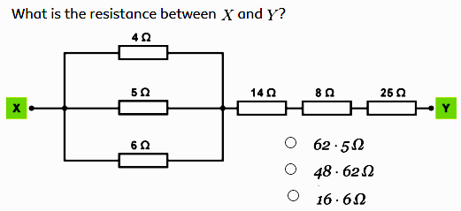
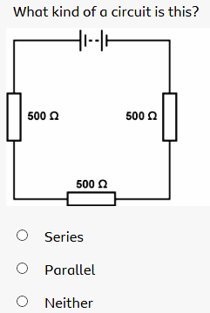
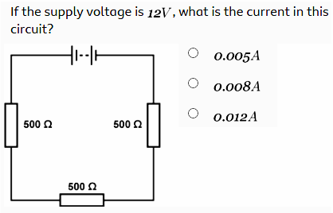
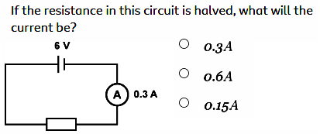
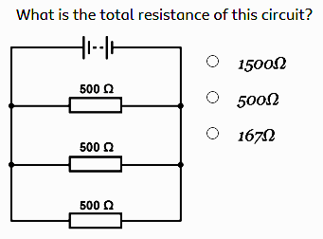
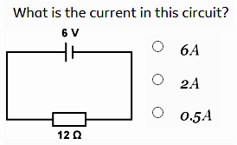
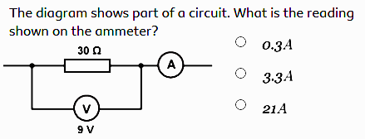
20-5n
E-Laws B | Jméno: | Třída: | Datum:
https://www.bbc.com/bitesize/guides/z8b2pv4/test

Slide 46
20-5n
E-Laws A | Jméno: | Třída: | Datum:
https://www.bbc.com/bitesize/guides/z8b2pv4/test

Slide 47
20-5n
E-Laws B | Jméno: | Třída: | Datum:
https://www.bbc.com/bitesize/guides/z8b2pv4/test

Slide 48
20-5n
E-Laws A | Jméno: | Třída: | Datum:
https://www.bbc.com/bitesize/guides/z8b2pv4/test

Slide 49
20-5n
E-Laws B | Jméno: | Třída: | Datum:
https://www.bbc.com/bitesize/guides/z8b2pv4/test

Slide 50
20-5n
E-Laws A | Jméno: | Třída: | Datum:
https://www.bbc.com/bitesize/guides/z8b2pv4/test

Slide 51
20-5n
E-Laws B | Jméno: | Třída: | Datum:
https://www.bbc.com/bitesize/guides/z8b2pv4/test

Slide 52
20-5n
E-Laws A | Jméno: | Třída: | Datum:
https://www.bbc.com/bitesize/guides/z8b2pv4/test

Slide 53
20-5n
E-Laws B | Jméno: | Třída: | Datum:
https://www.bbc.com/bitesize/guides/z8b2pv4/test

Slide 54
20-5n
E-Laws A | Jméno: | Třída: | Datum:
https://www.bbc.com/bitesize/guides/z8b2pv4/test

Slide 55
20-5n
E-Laws B | Jméno: | Třída: | Datum:
https://www.bbc.com/bitesize/guides/z8b2pv4/test

Slide 56
20-5n
E-Laws A | Jméno: | Třída: | Datum:
https://www.bbc.com/bitesize/guides/z8b2pv4/test

Slide 57
20-5n
E-Laws B | Jméno: | Třída: | Datum:
https://www.bbc.com/bitesize/guides/z8b2pv4/test

Slide 58
Container
Kirchhoff‘s current law – Kirchhoffův zákon o proudech
Kirchhoff‘s voltage law – Kirchhoffův zákon o napětích
Ohm‘s law – Ohmův zákon
using the Ohm‘s law - pomocí Ohmova zákona
We can use the Ohm’s law to calculate the current. - Můžeme použít Ohmův zákon k výpočtu toho proudu.
http://www.allaboutcircuits.com/vol_1/chpt_2/1.html

Slide 59
Container
Voltage / The force motivating electrons to flow
Current / Movement of electrons
Resistance / Opposition to motion of electrons
current / The higher the voltage, the higher the...
lower / The higher the resistance, the ... the current
volts / The voltage drop is measured in ...
amperes / The current is measured in ...
ohms / The resistance is measured in ...
parallel / resistors can be connected in series or in ...
Kirchhoff / The author of the current and voltage laws

